Slide 1
EXPLORATORY ANALYSIS OF AGRICULTURE IN MAHARASHTRA
A Project Report Submitted by:
1.Yogesh Pokale
2.Siddharth chandurkar

Slide 2
INDEX
Introduction
Description of data
Steps involved in processing of data
Python code
Data visualisation and interpretation
Conclusion

Slide 3
Agriculture in Maharashtra
Agriculture contributes 13.2% of the total GDP of the state and demands 51% of total labour force by occupation
82% of rural population depends on agriculture for livelihood.
Both food crops and cash crops are grown
Emerging as an important horticultural state in country.

Slide 4
Description of the data
The following dataset contains yearly production of major crops in various districts of Maharashtra over the last 51 years from 1966 to 2017.
Columns:
Year : respective year between 1966 to 2017 from which the data is based.
Dist. name: name of the subsequent district
Production: total production of given crop with a unit taken per 1000 metric tonnes.
Yield: Total yield of a given crop with a unit taken in kgs per hectare
Area: Total area where the given crop was cultivated with a unit taken per 1000 hectares.

Slide 5
Steps involved in processing of data
Python language is used

Slide 6
Data visualisation
By using bar plots

Slide 7
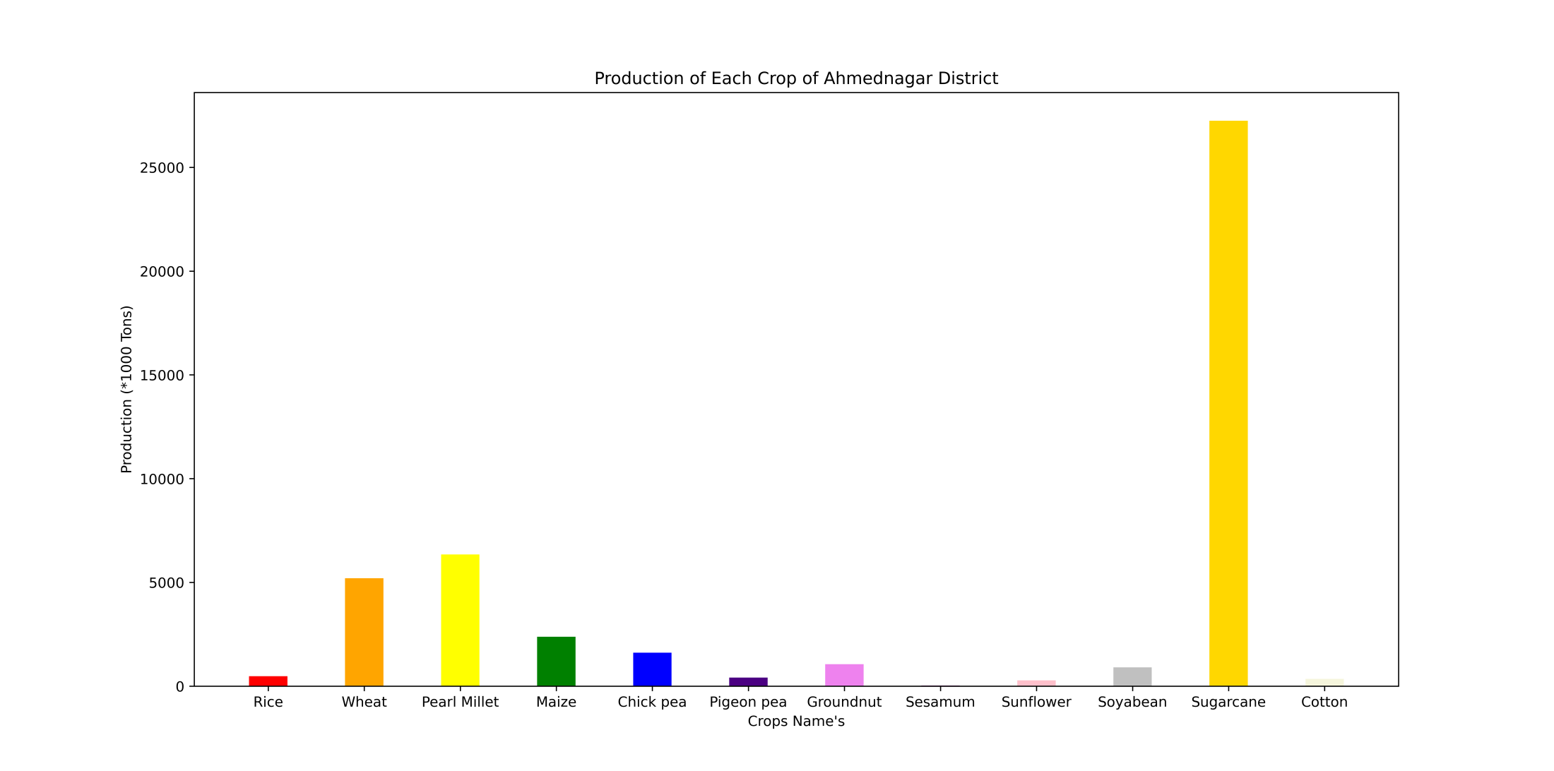

Slide 8
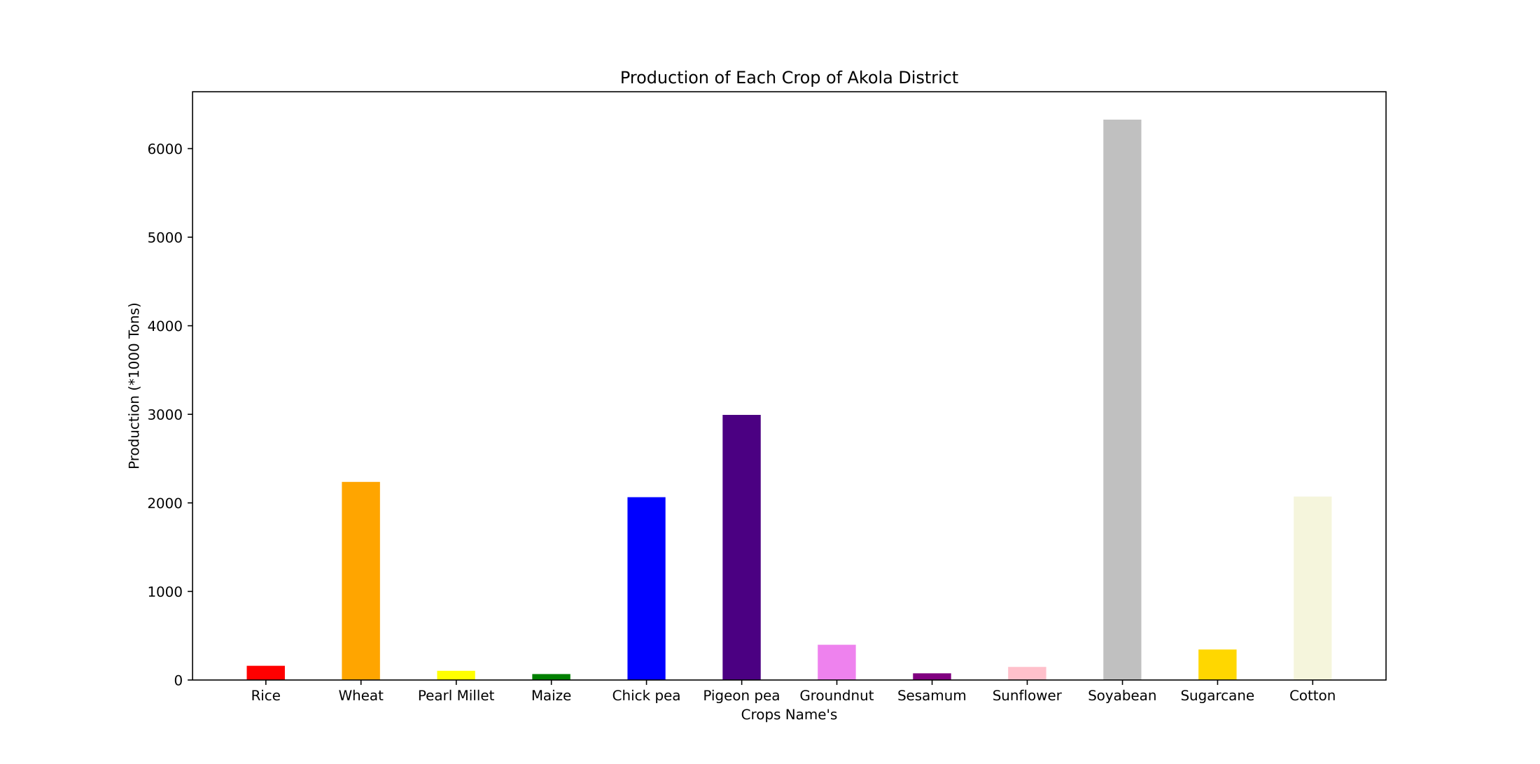

Slide 9
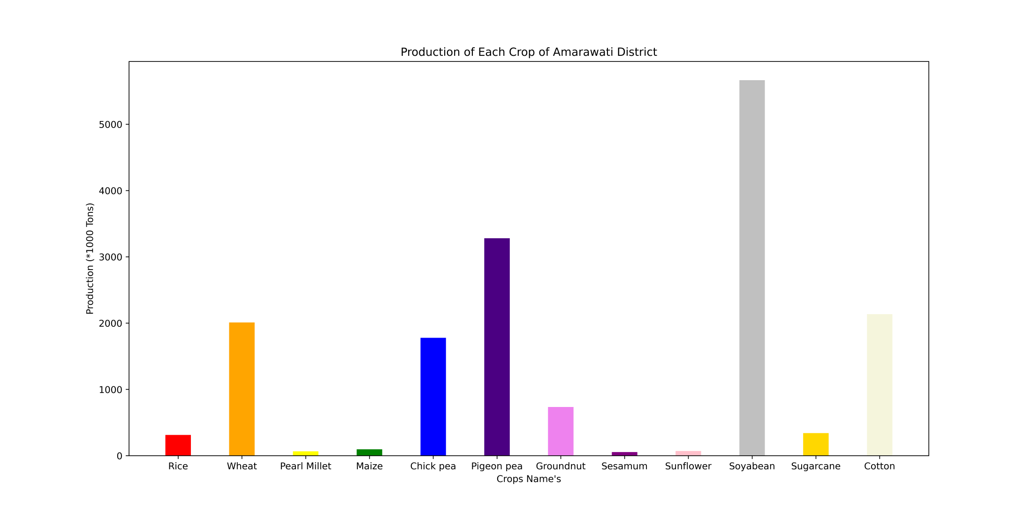

Slide 10
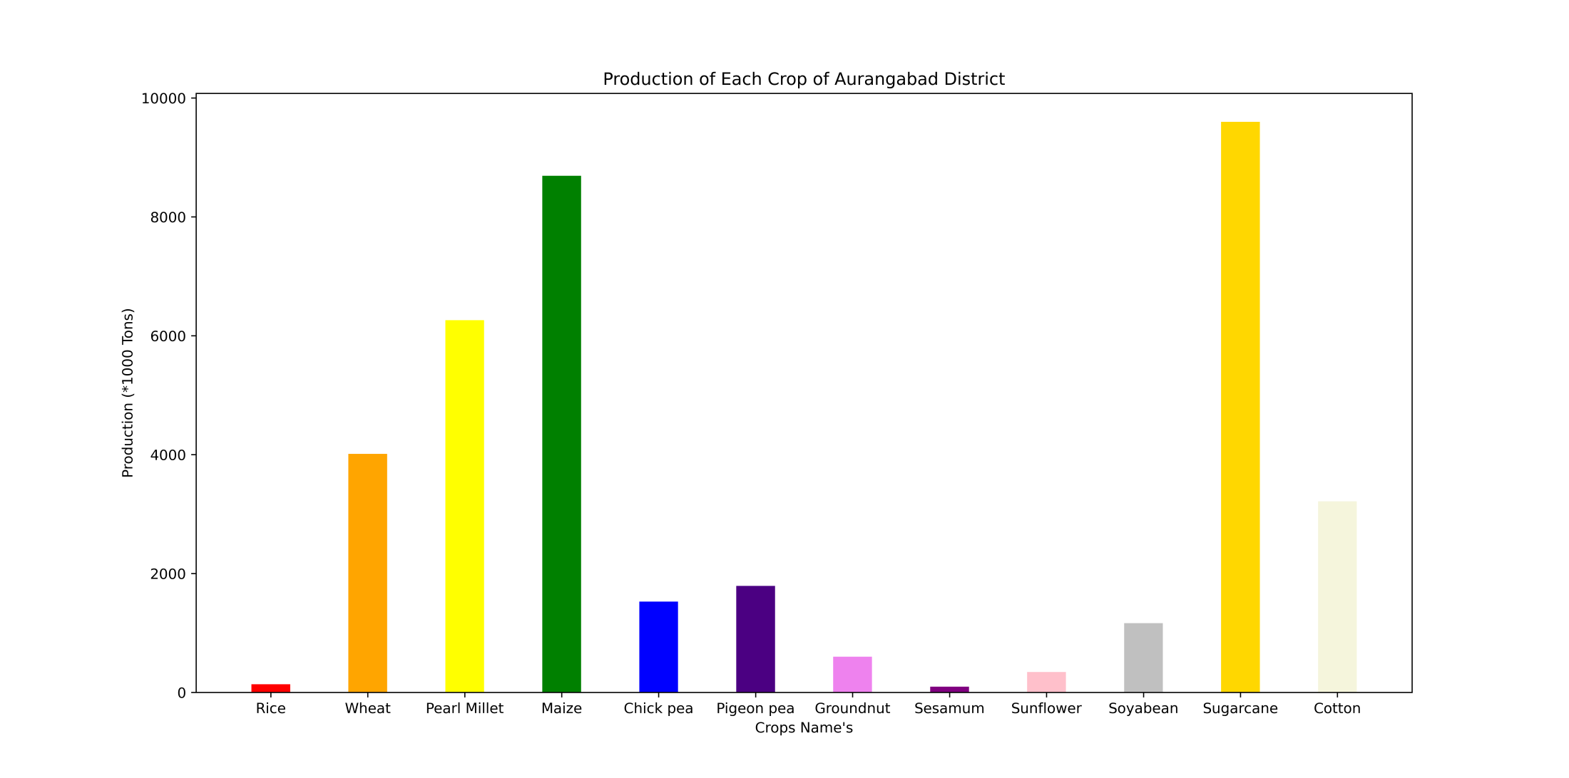

Slide 11
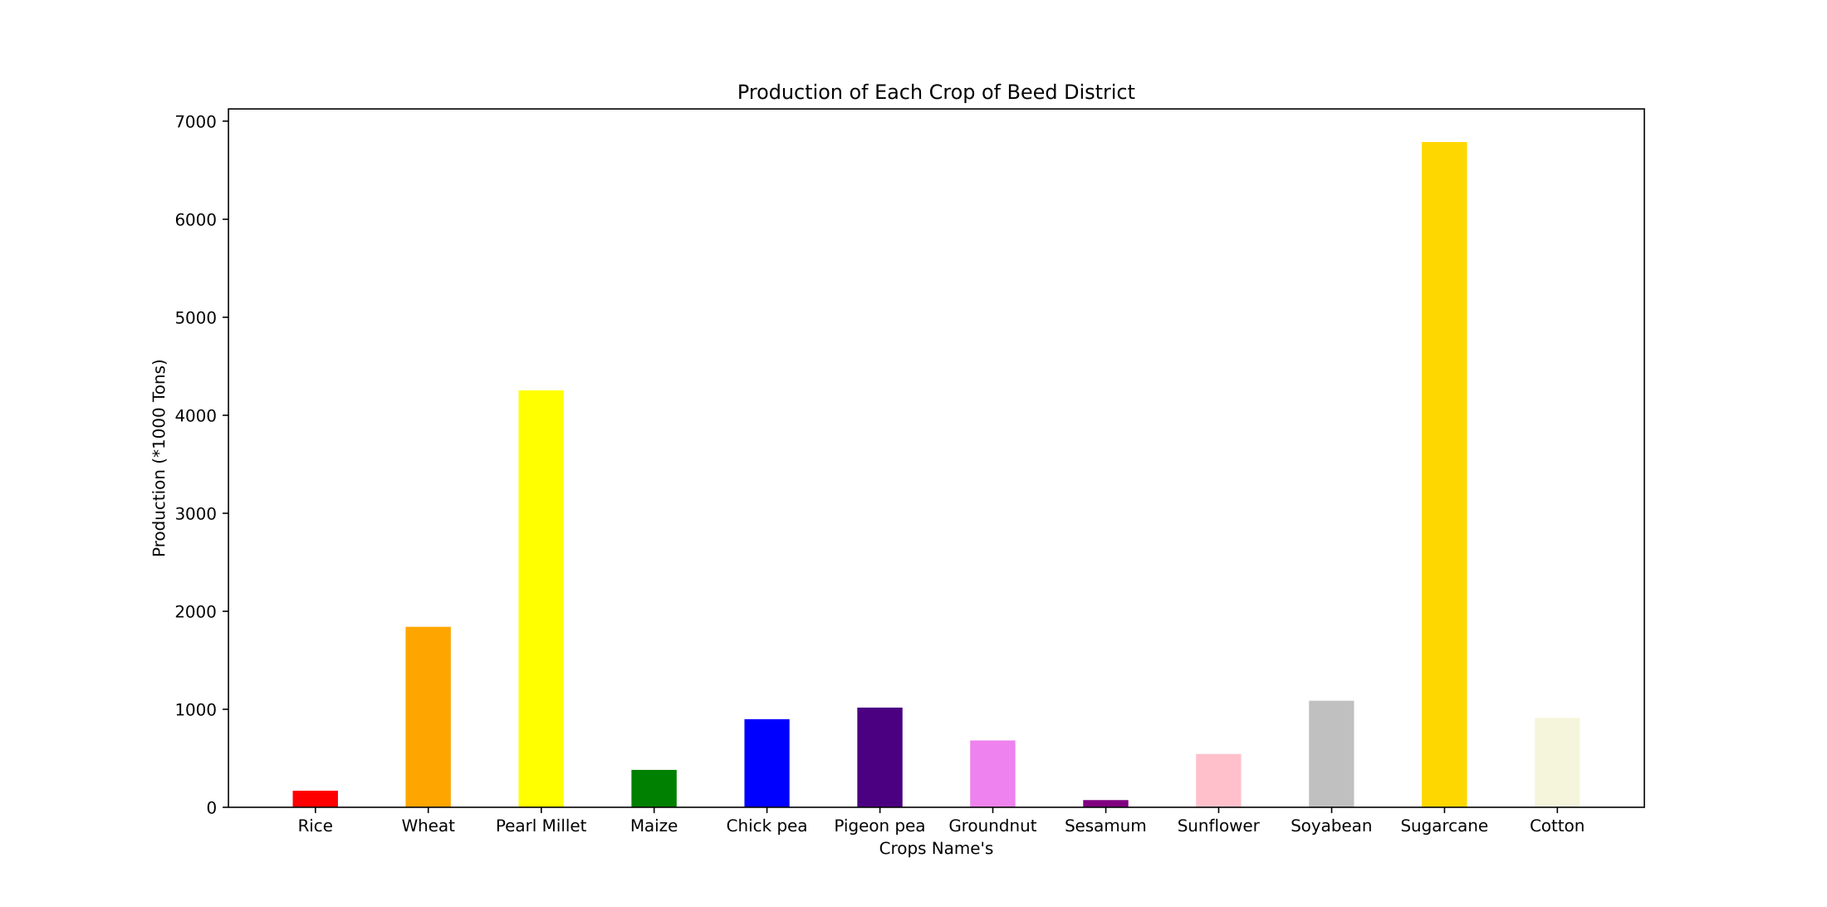

Slide 12
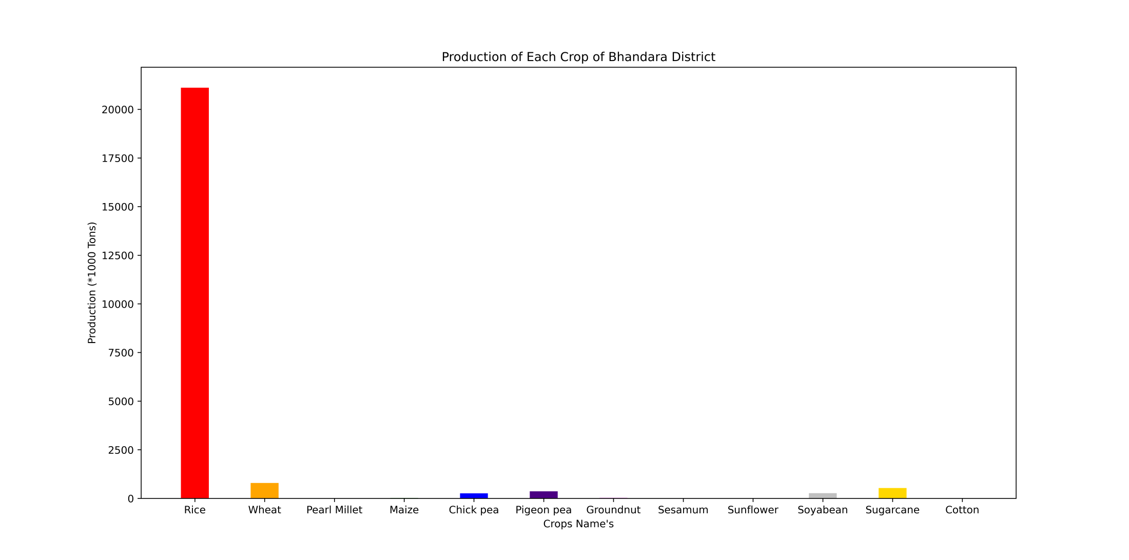

Slide 13
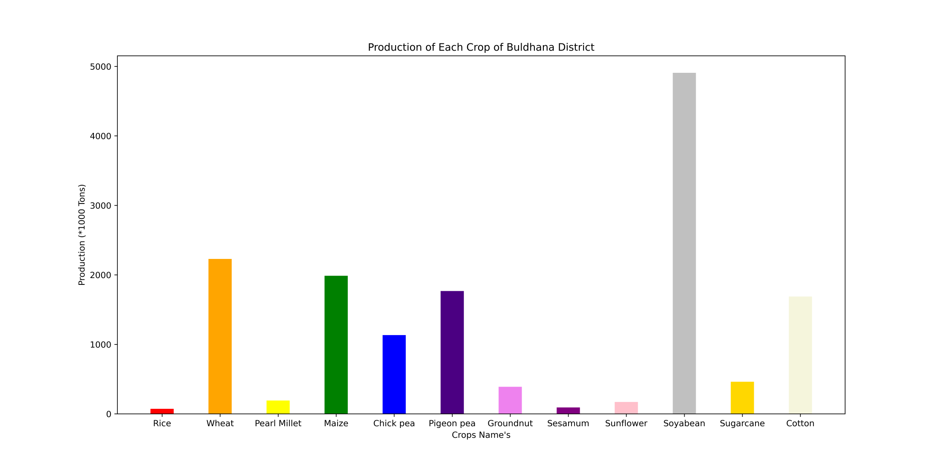

Slide 14
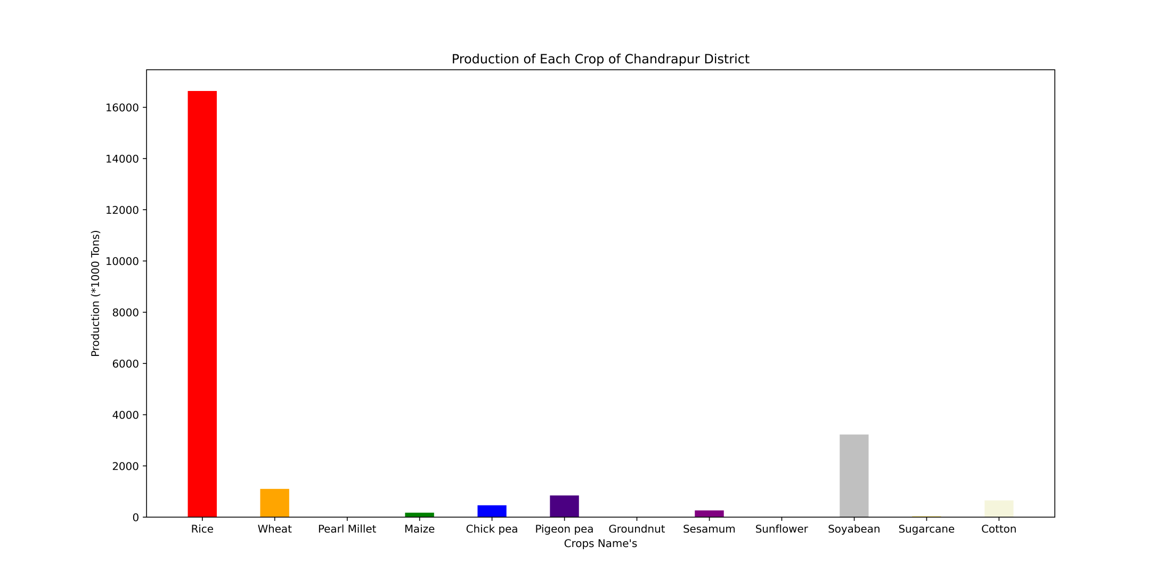

Slide 15
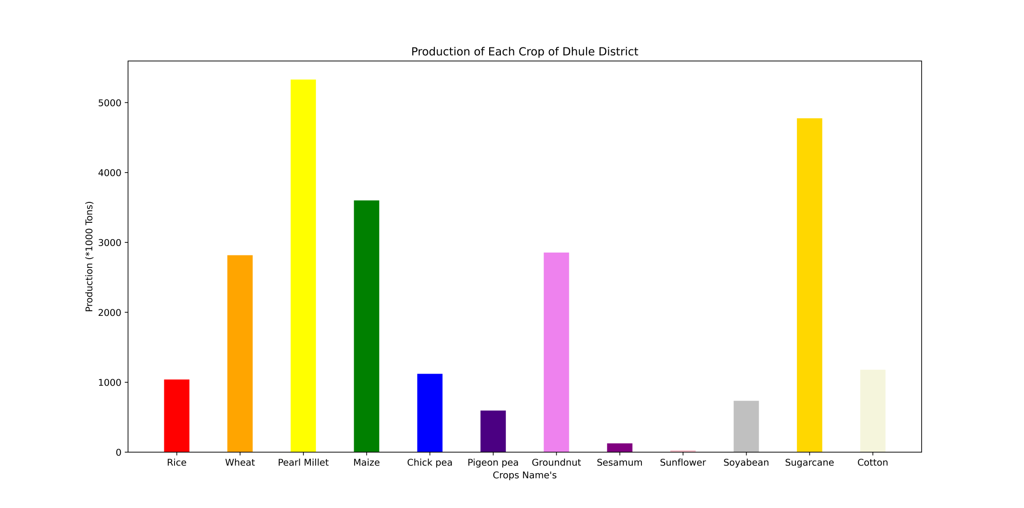

Slide 16
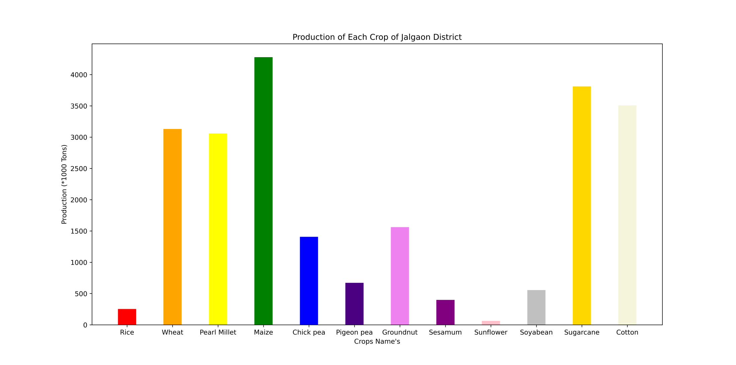

Slide 17
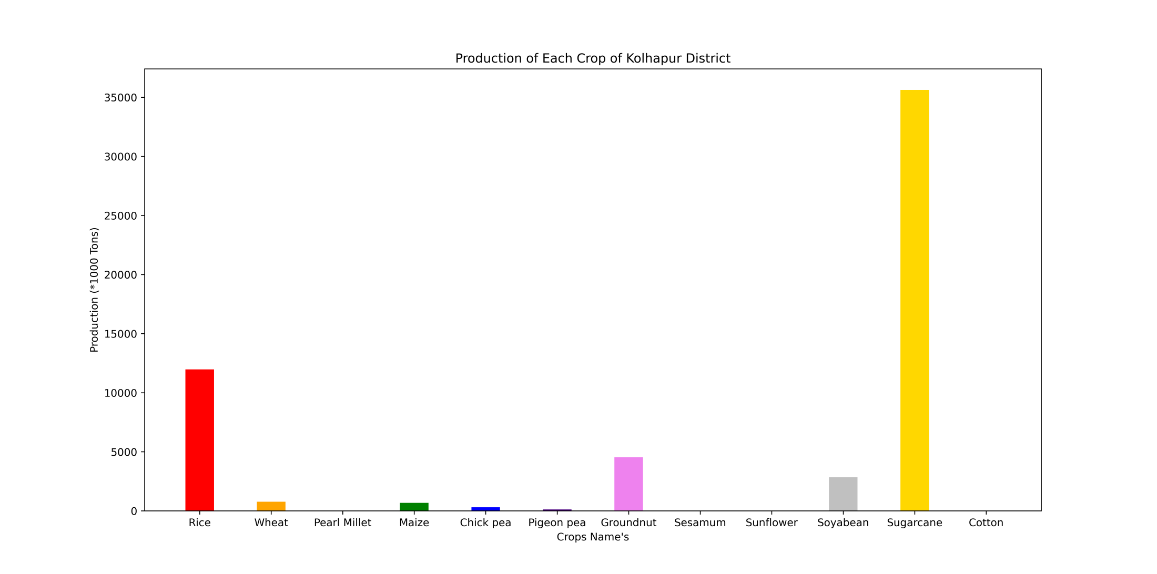

Slide 18
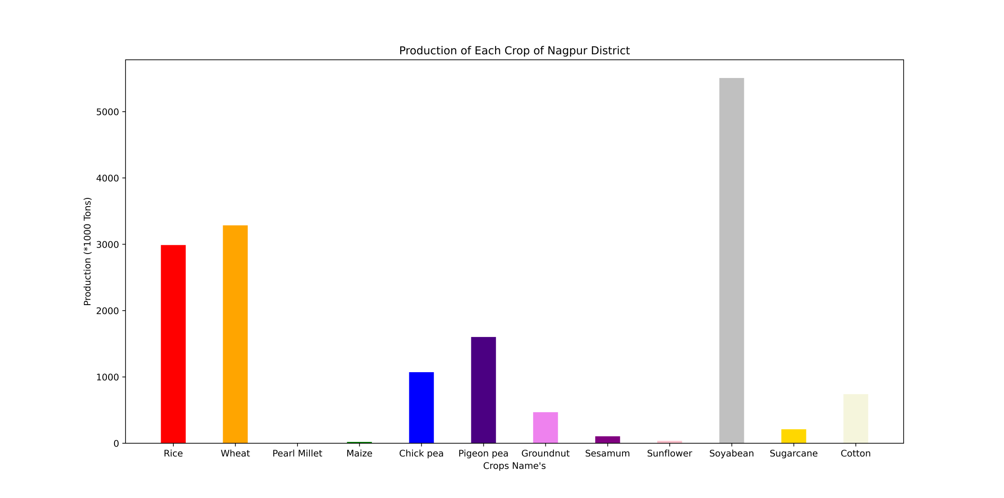

Slide 19
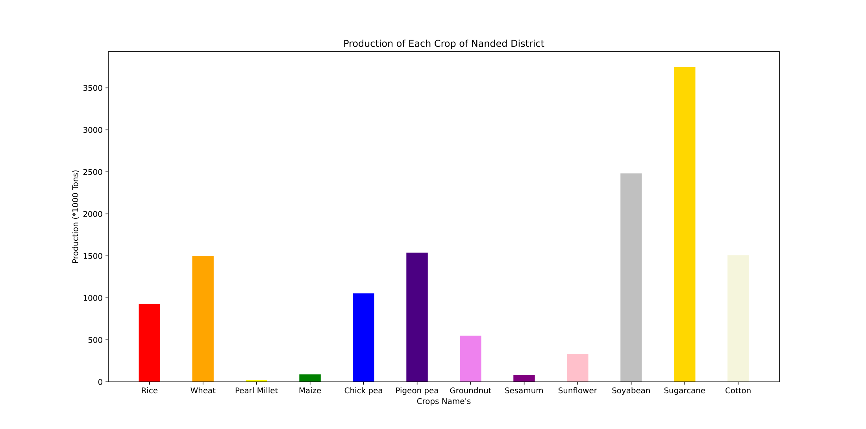

Slide 20
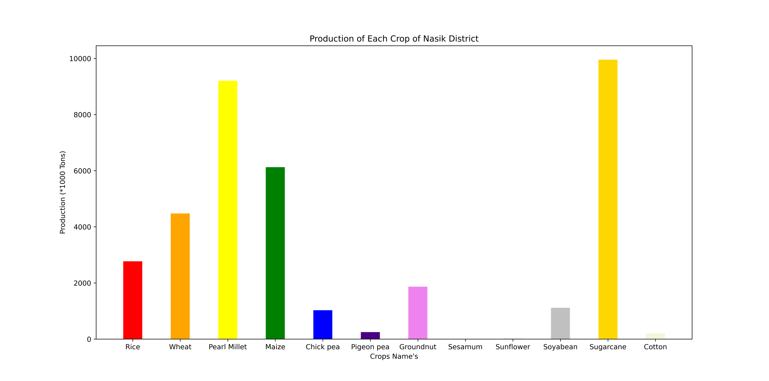

Slide 21
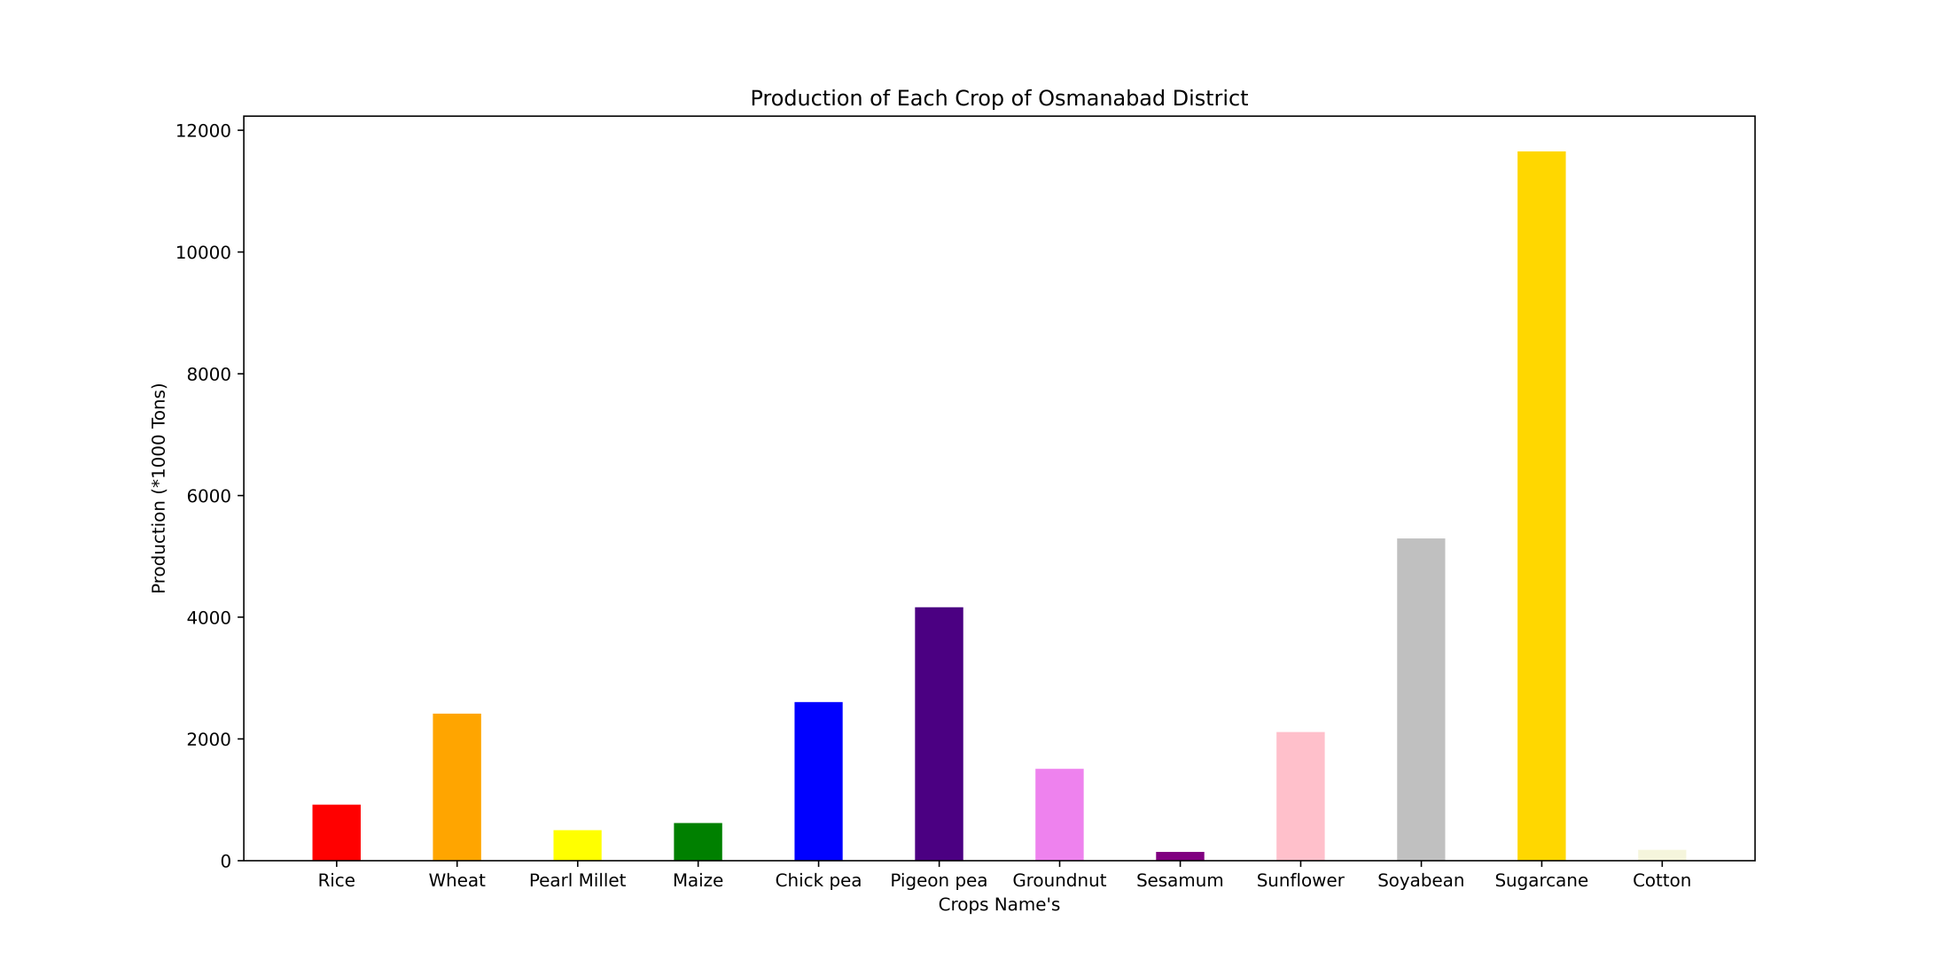

Slide 22
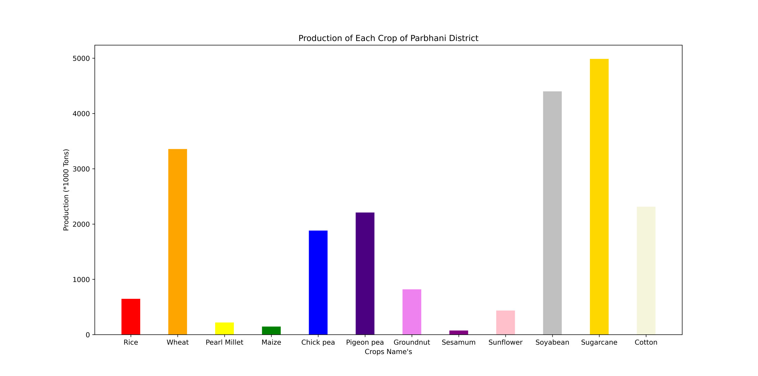

Slide 23
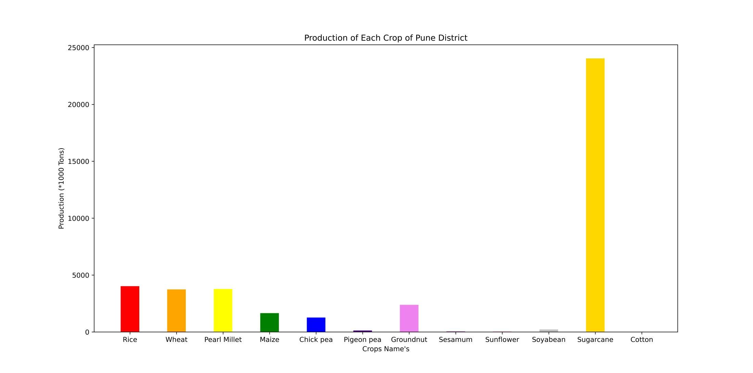

Slide 24
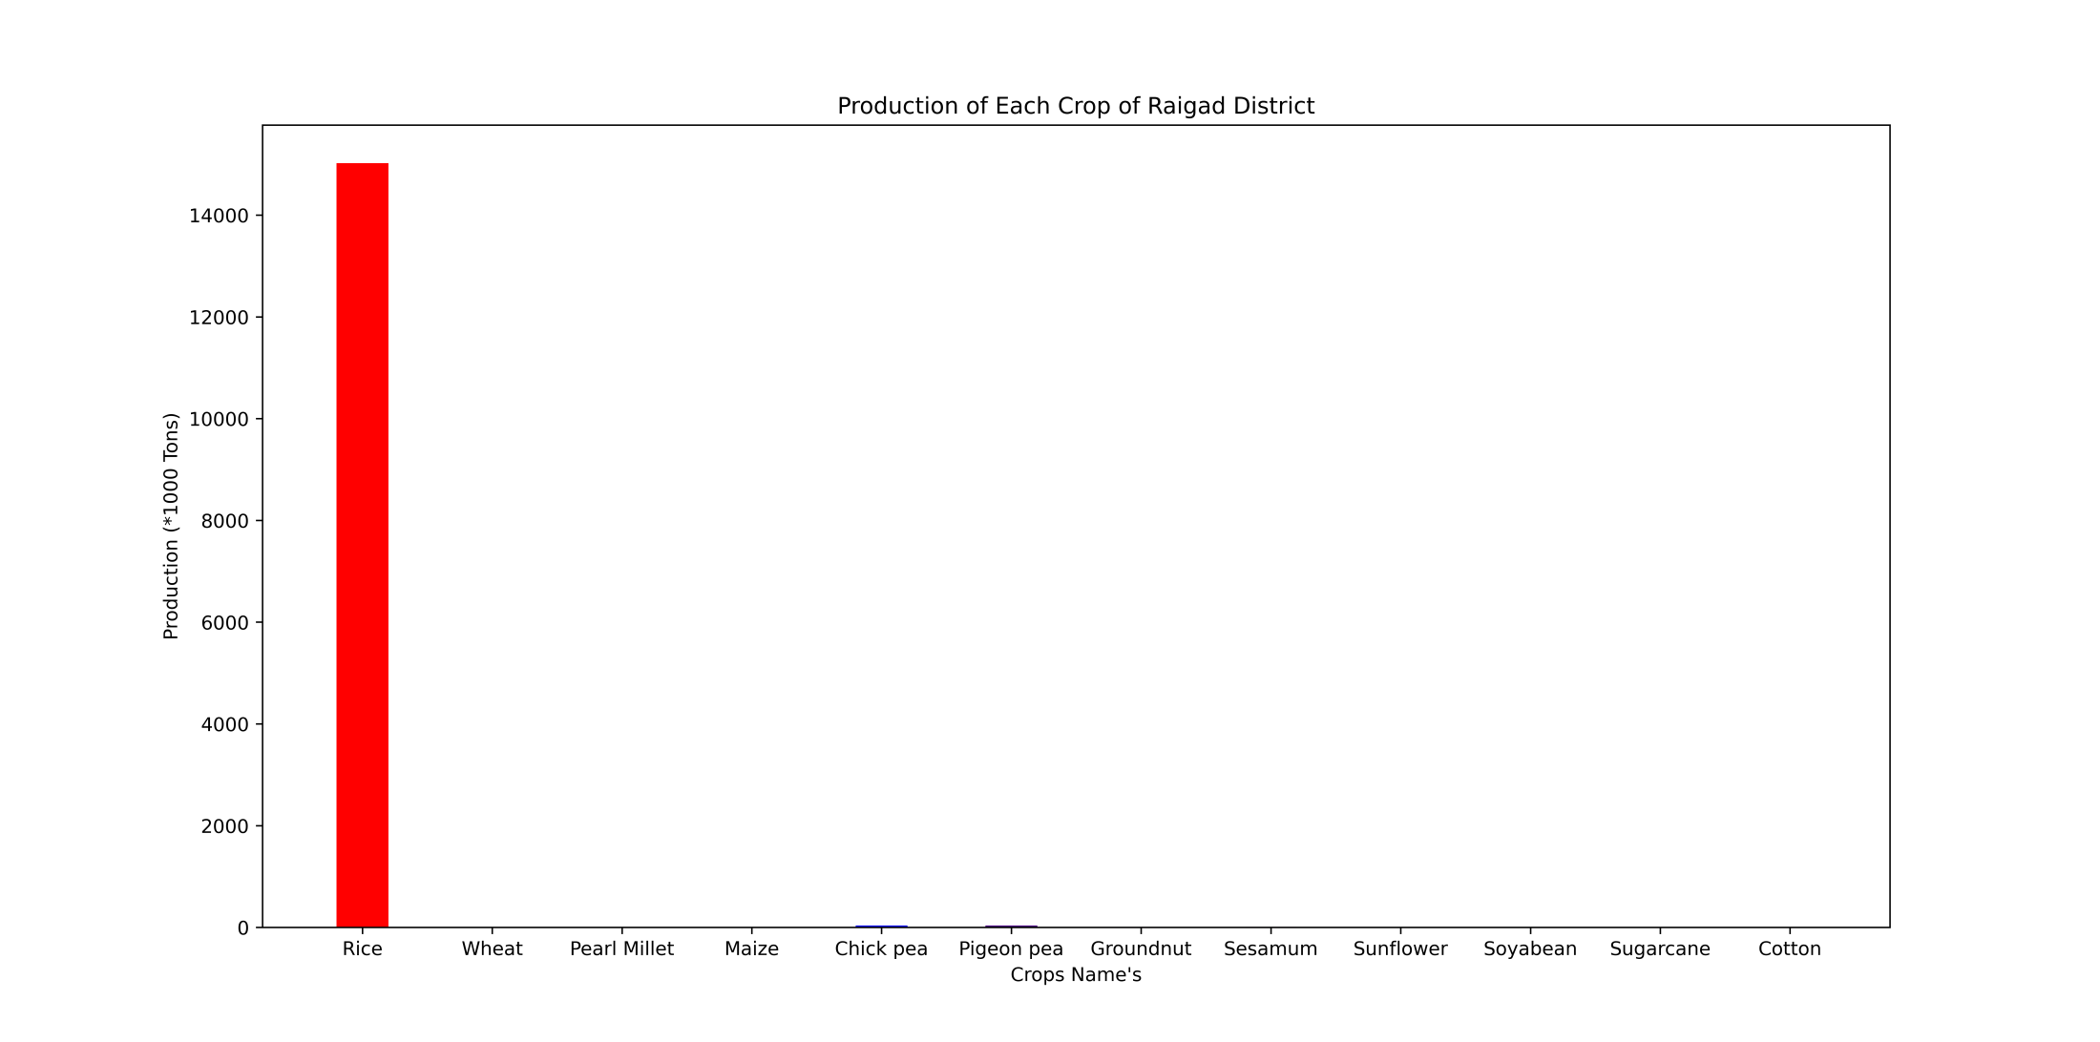

Slide 25
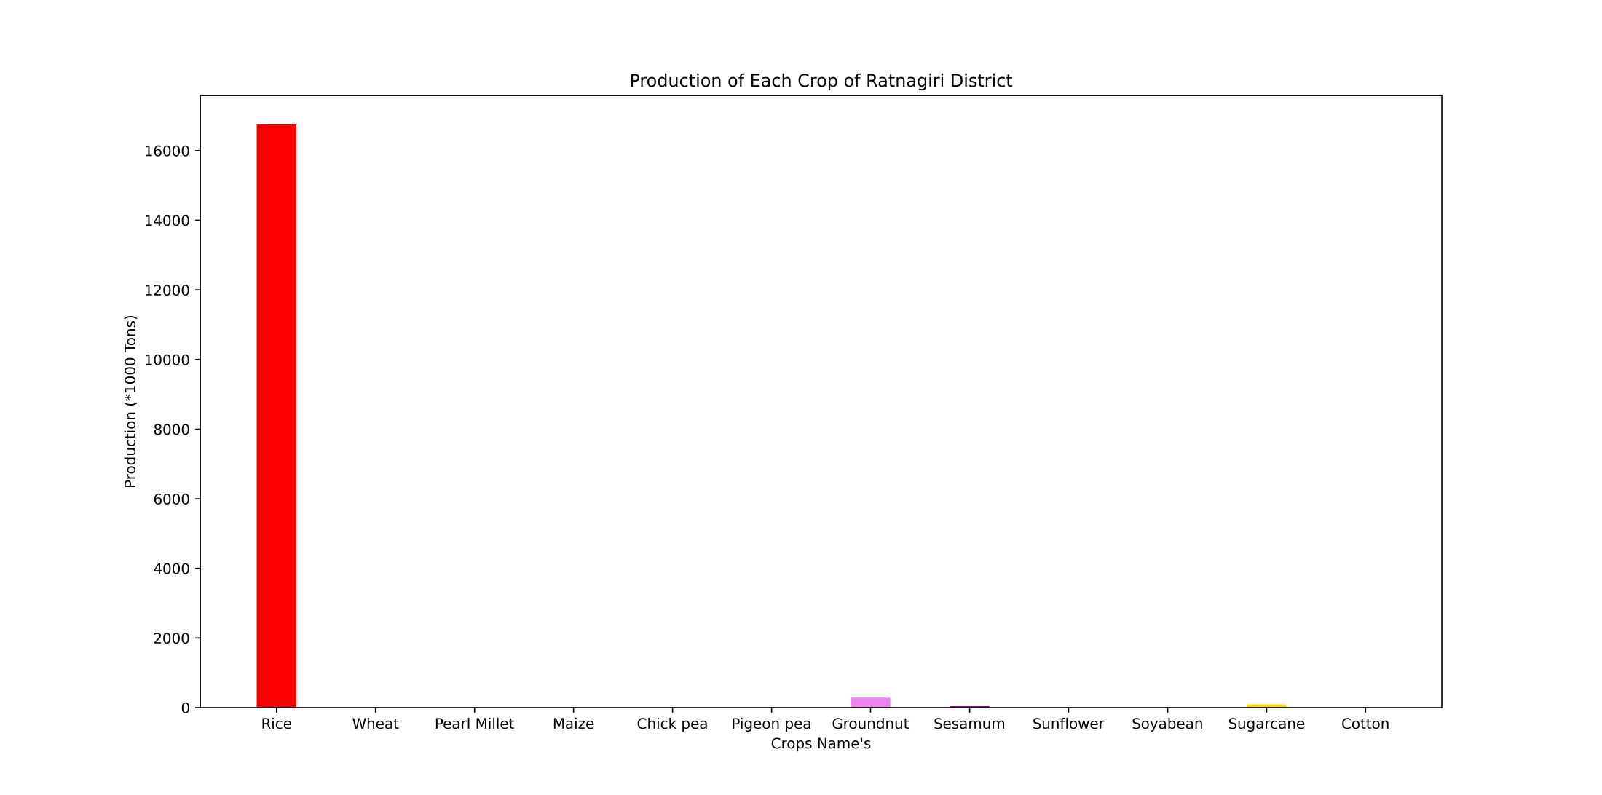

Slide 26
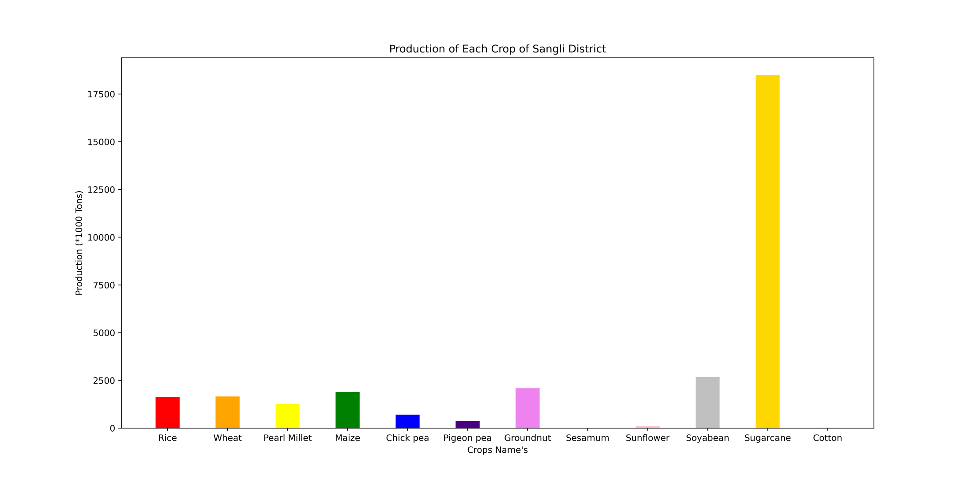

Slide 27
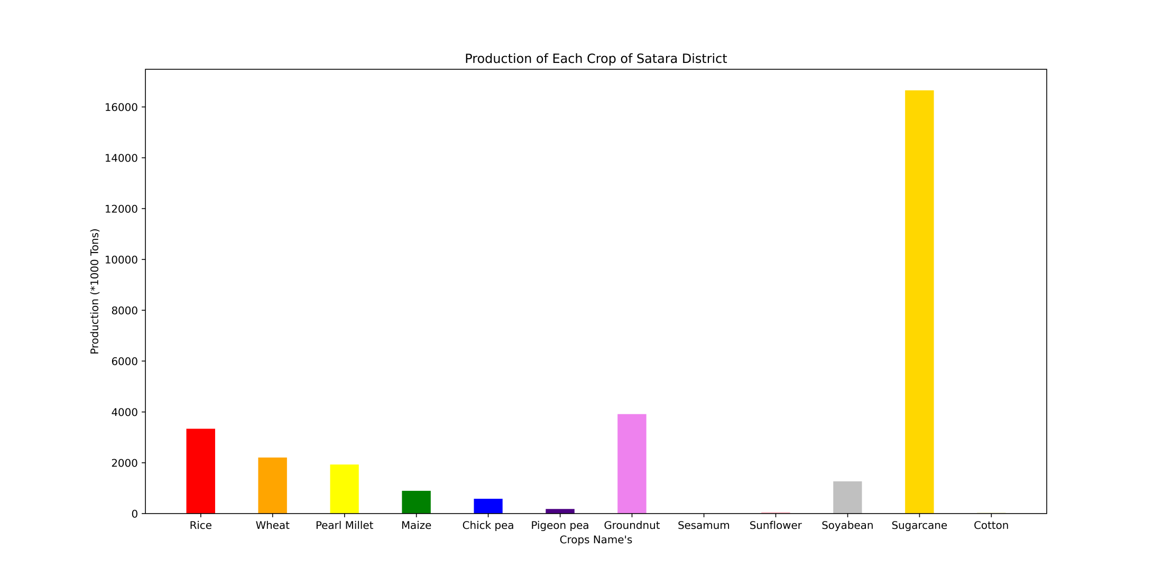

Slide 28
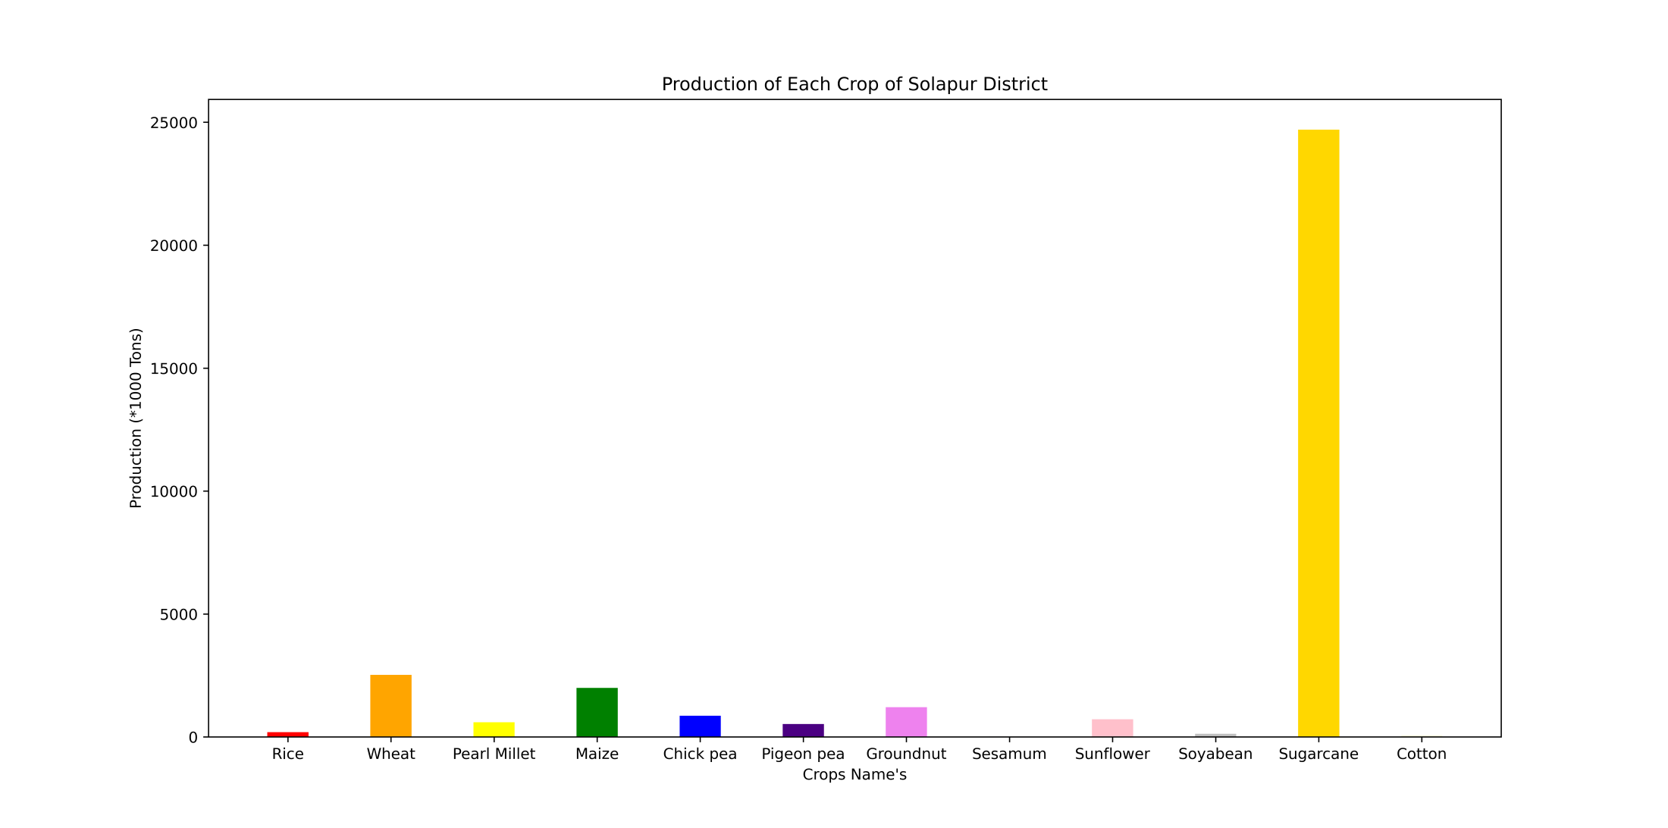

Slide 29
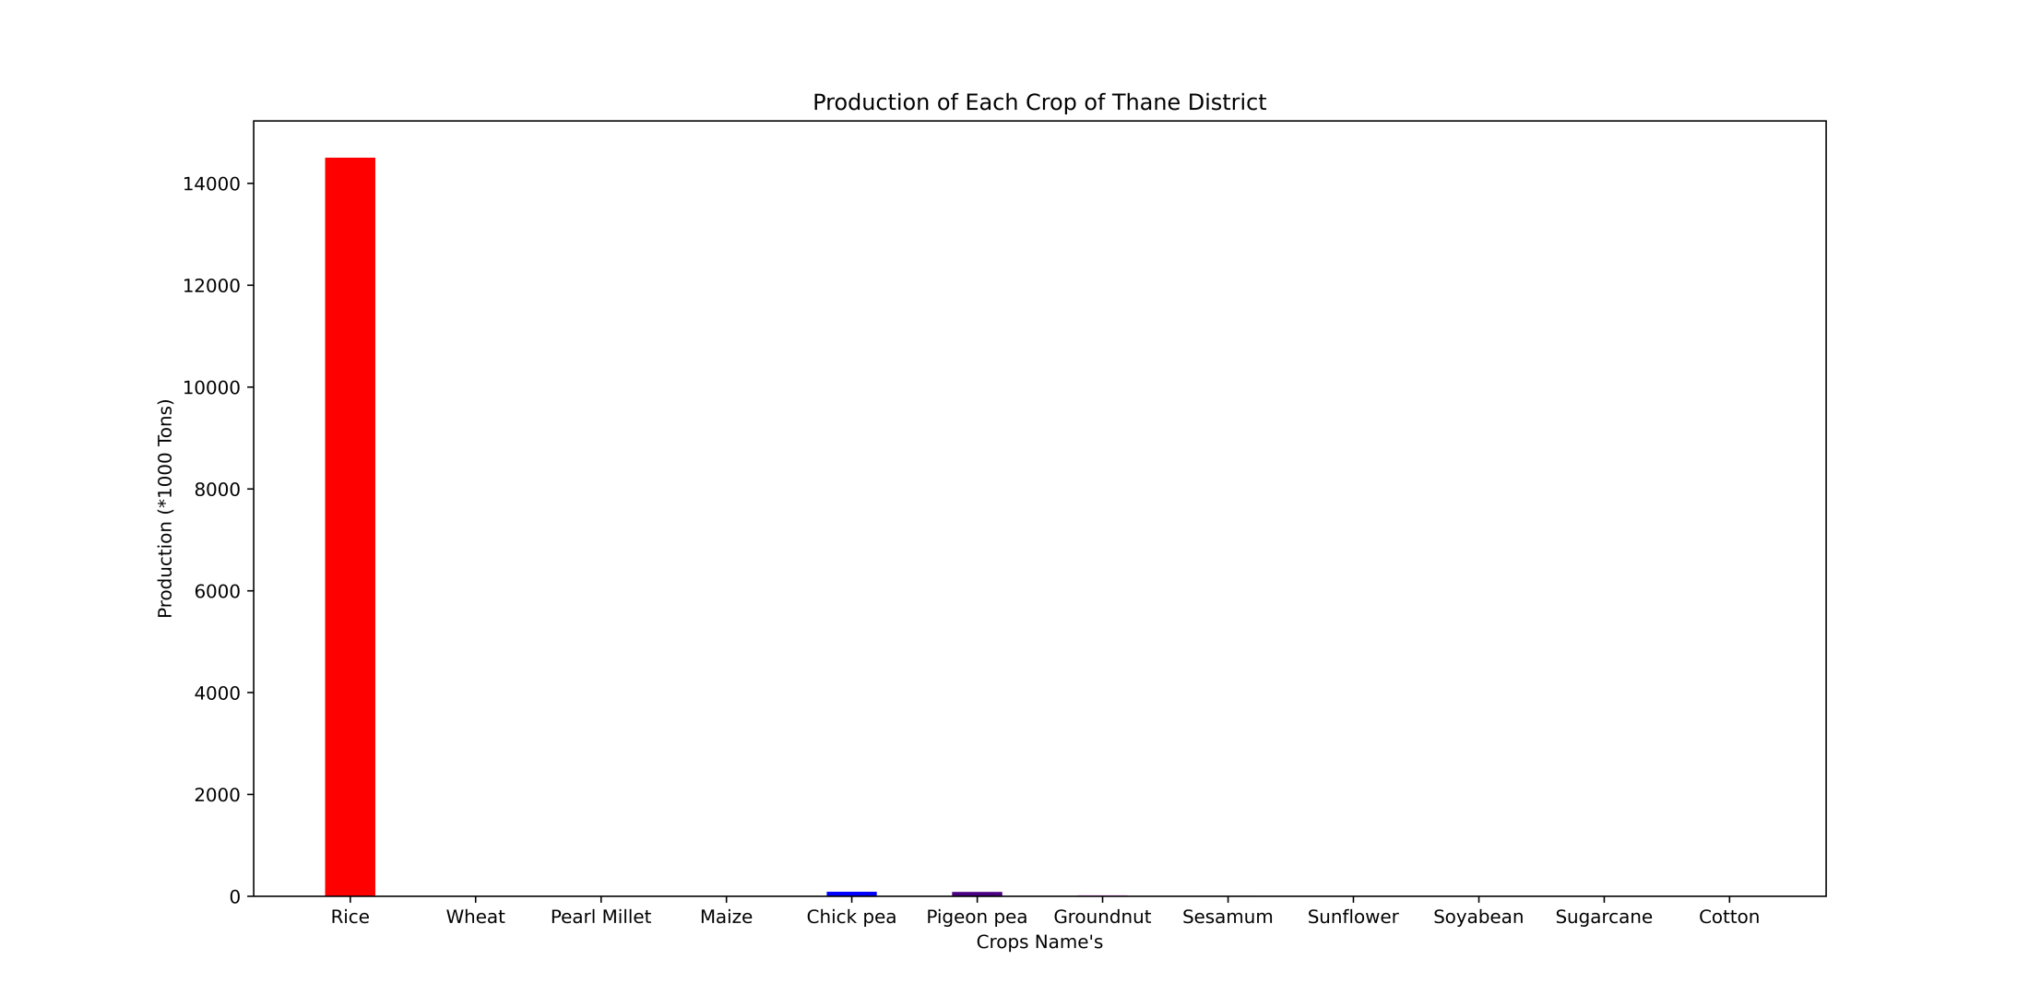

Slide 30
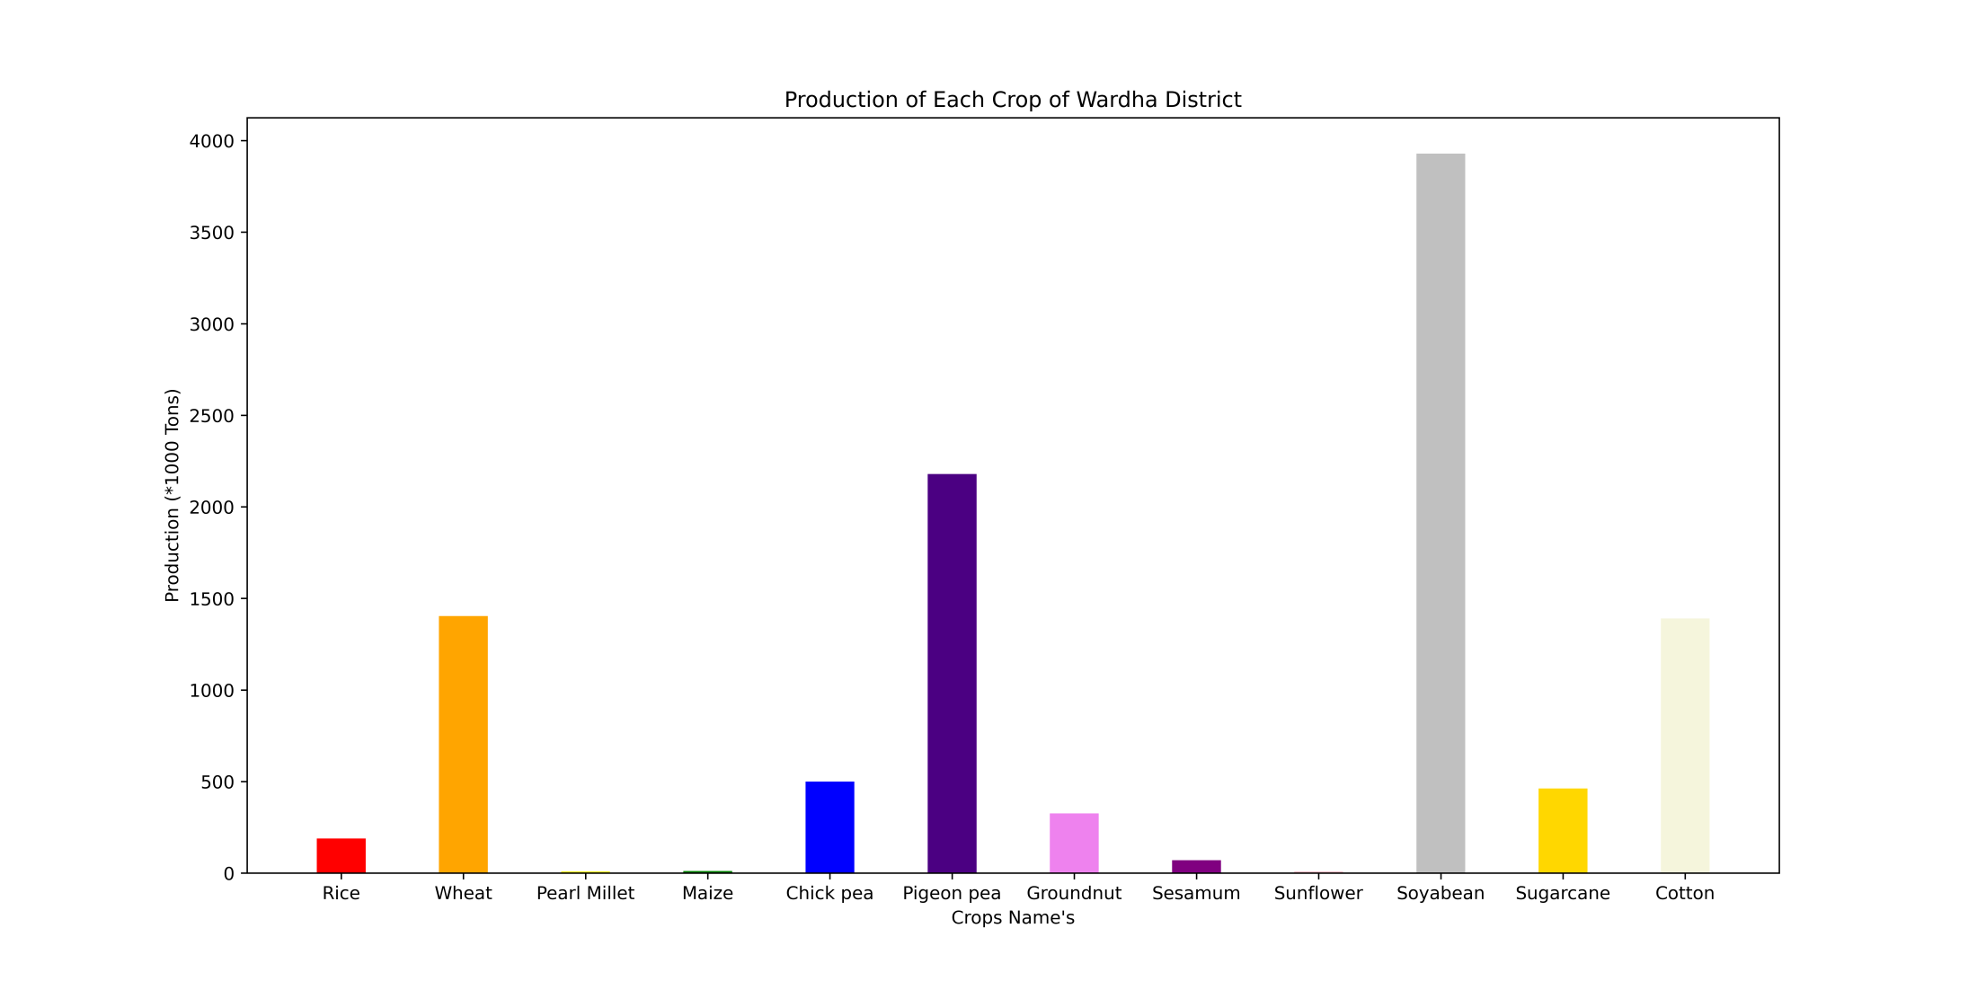

Slide 31
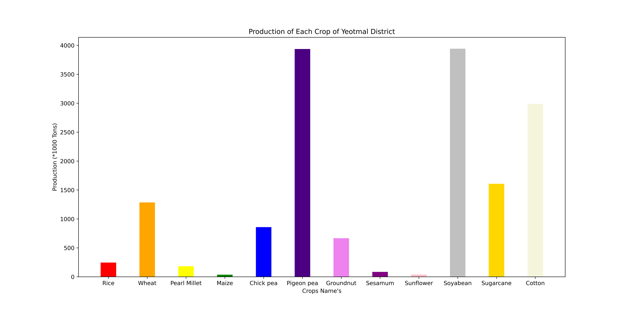

Slide 32
By using pie charts

Slide 33
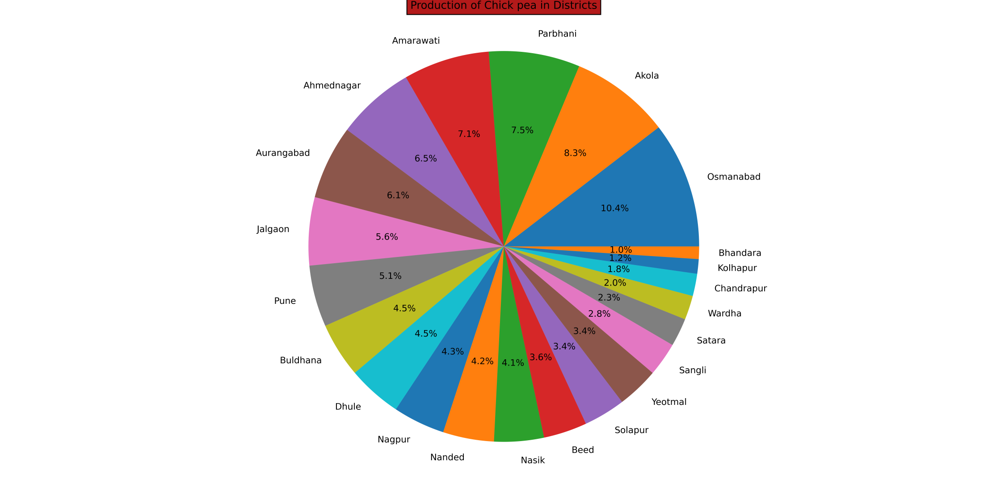

Slide 34
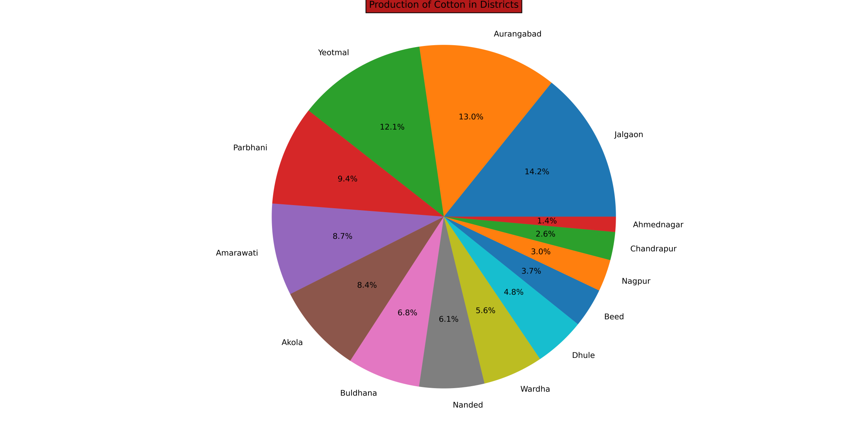

Slide 35
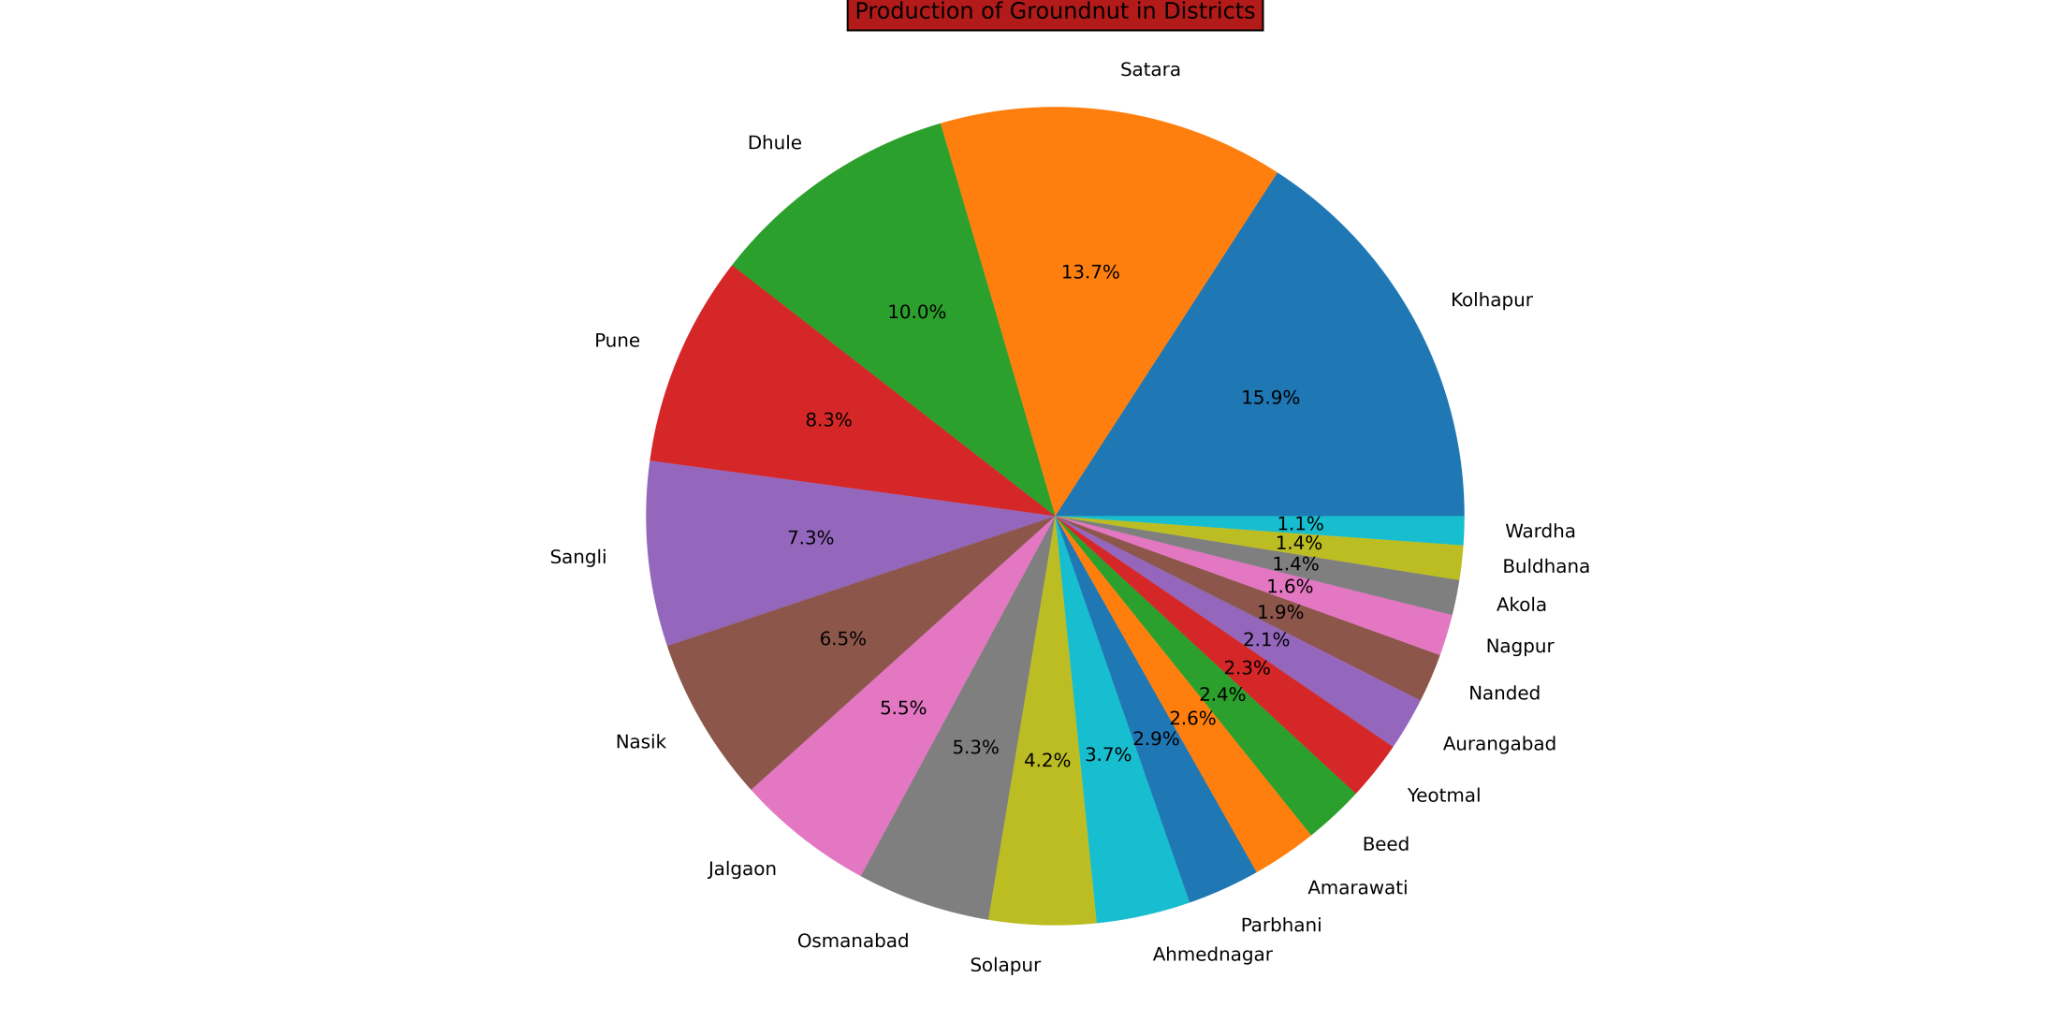

Slide 36
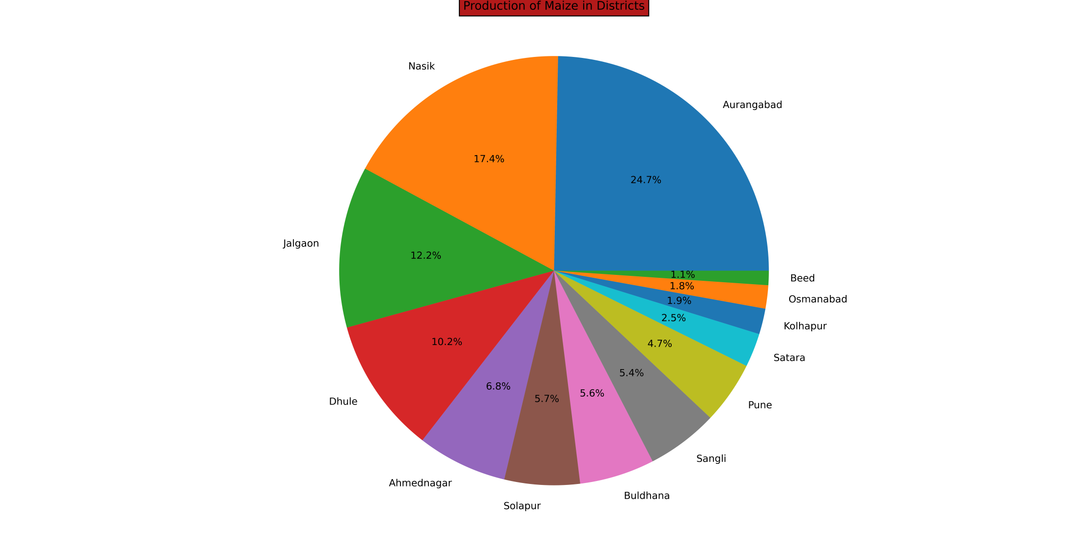

Slide 37
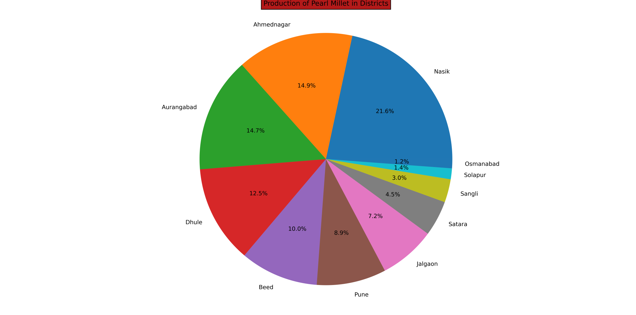

Slide 38
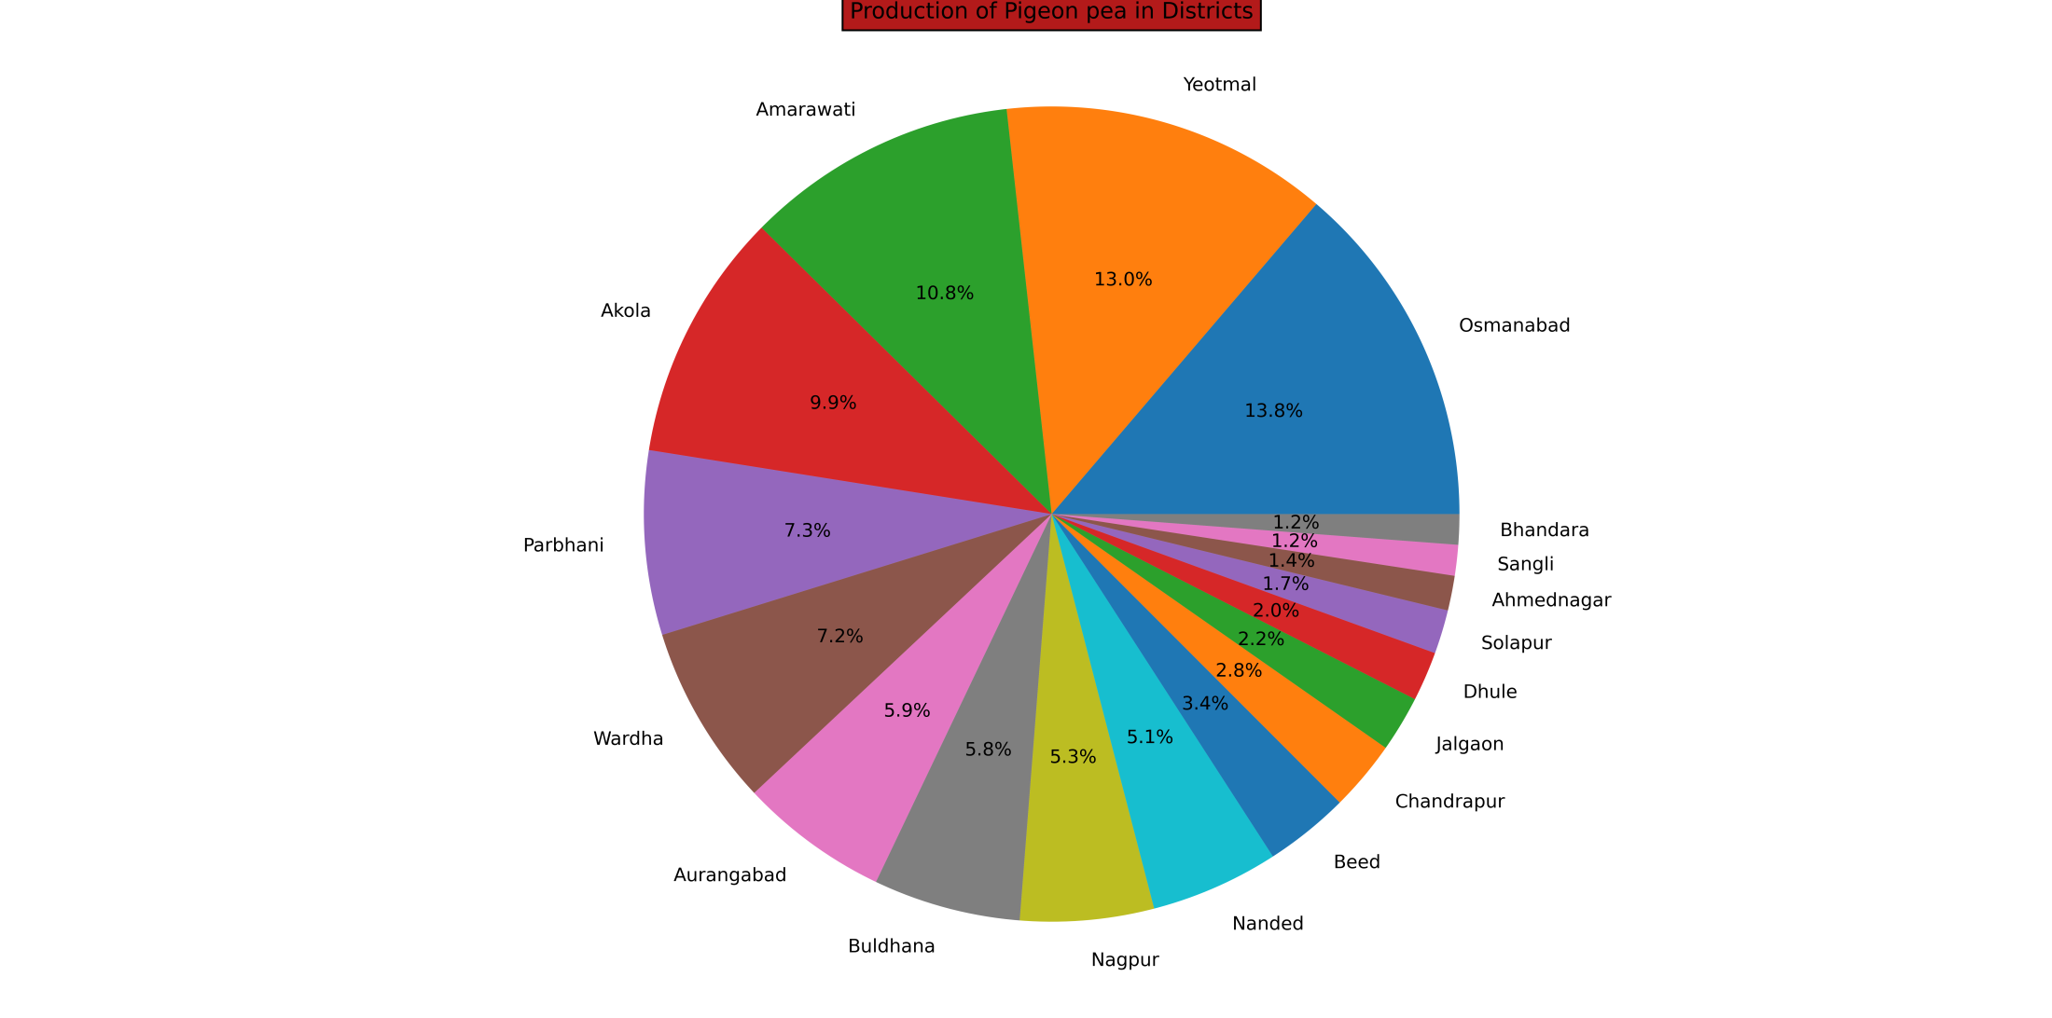

Slide 39
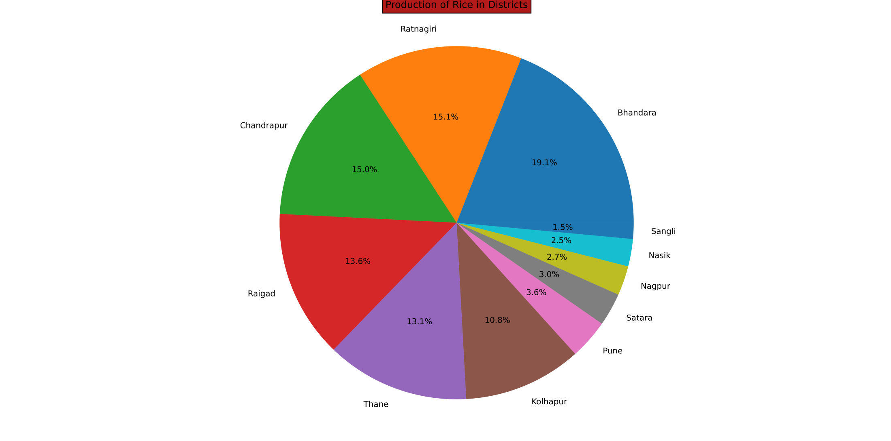

Slide 40
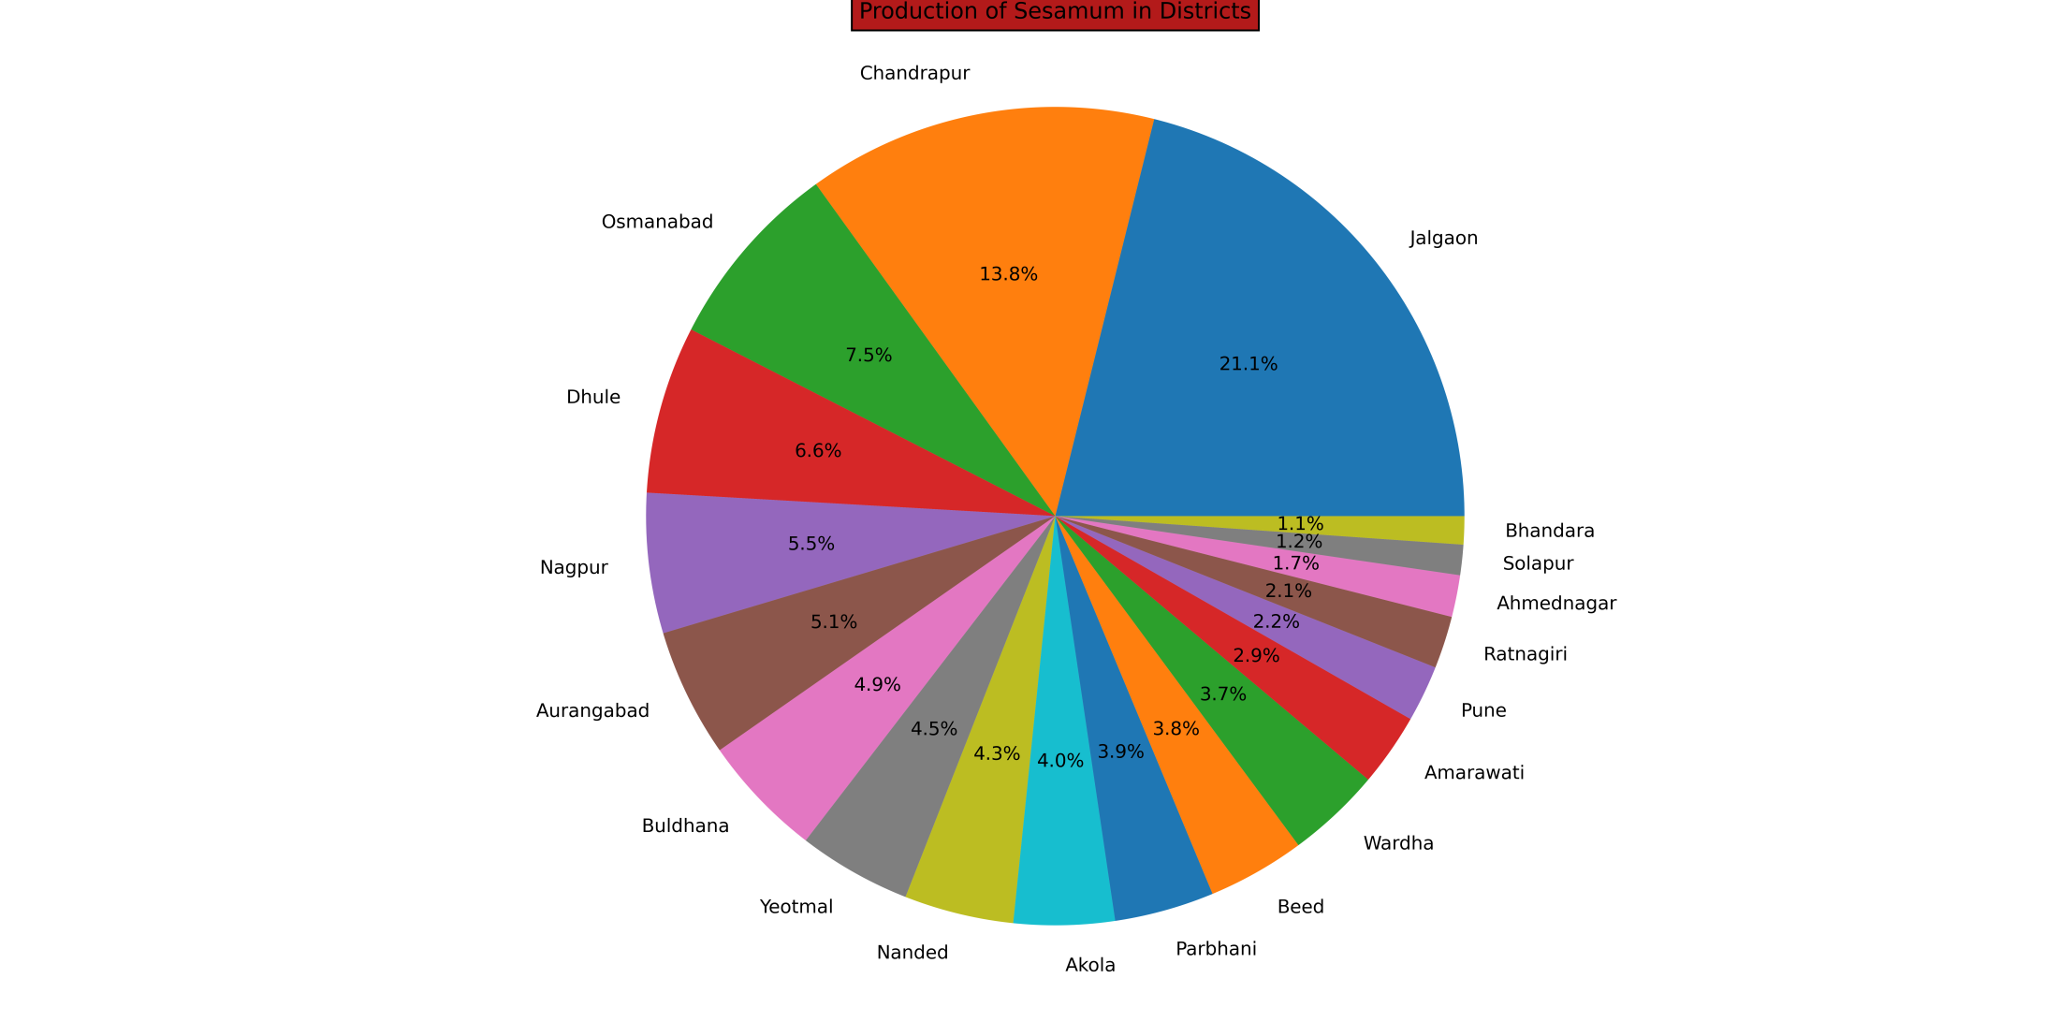

Slide 41
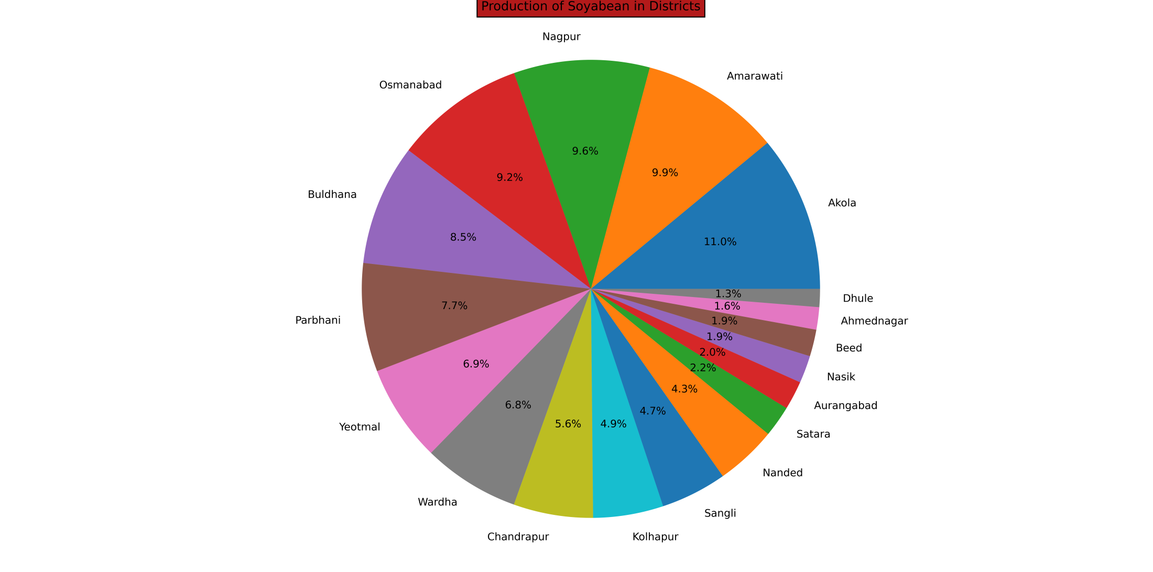

Slide 42
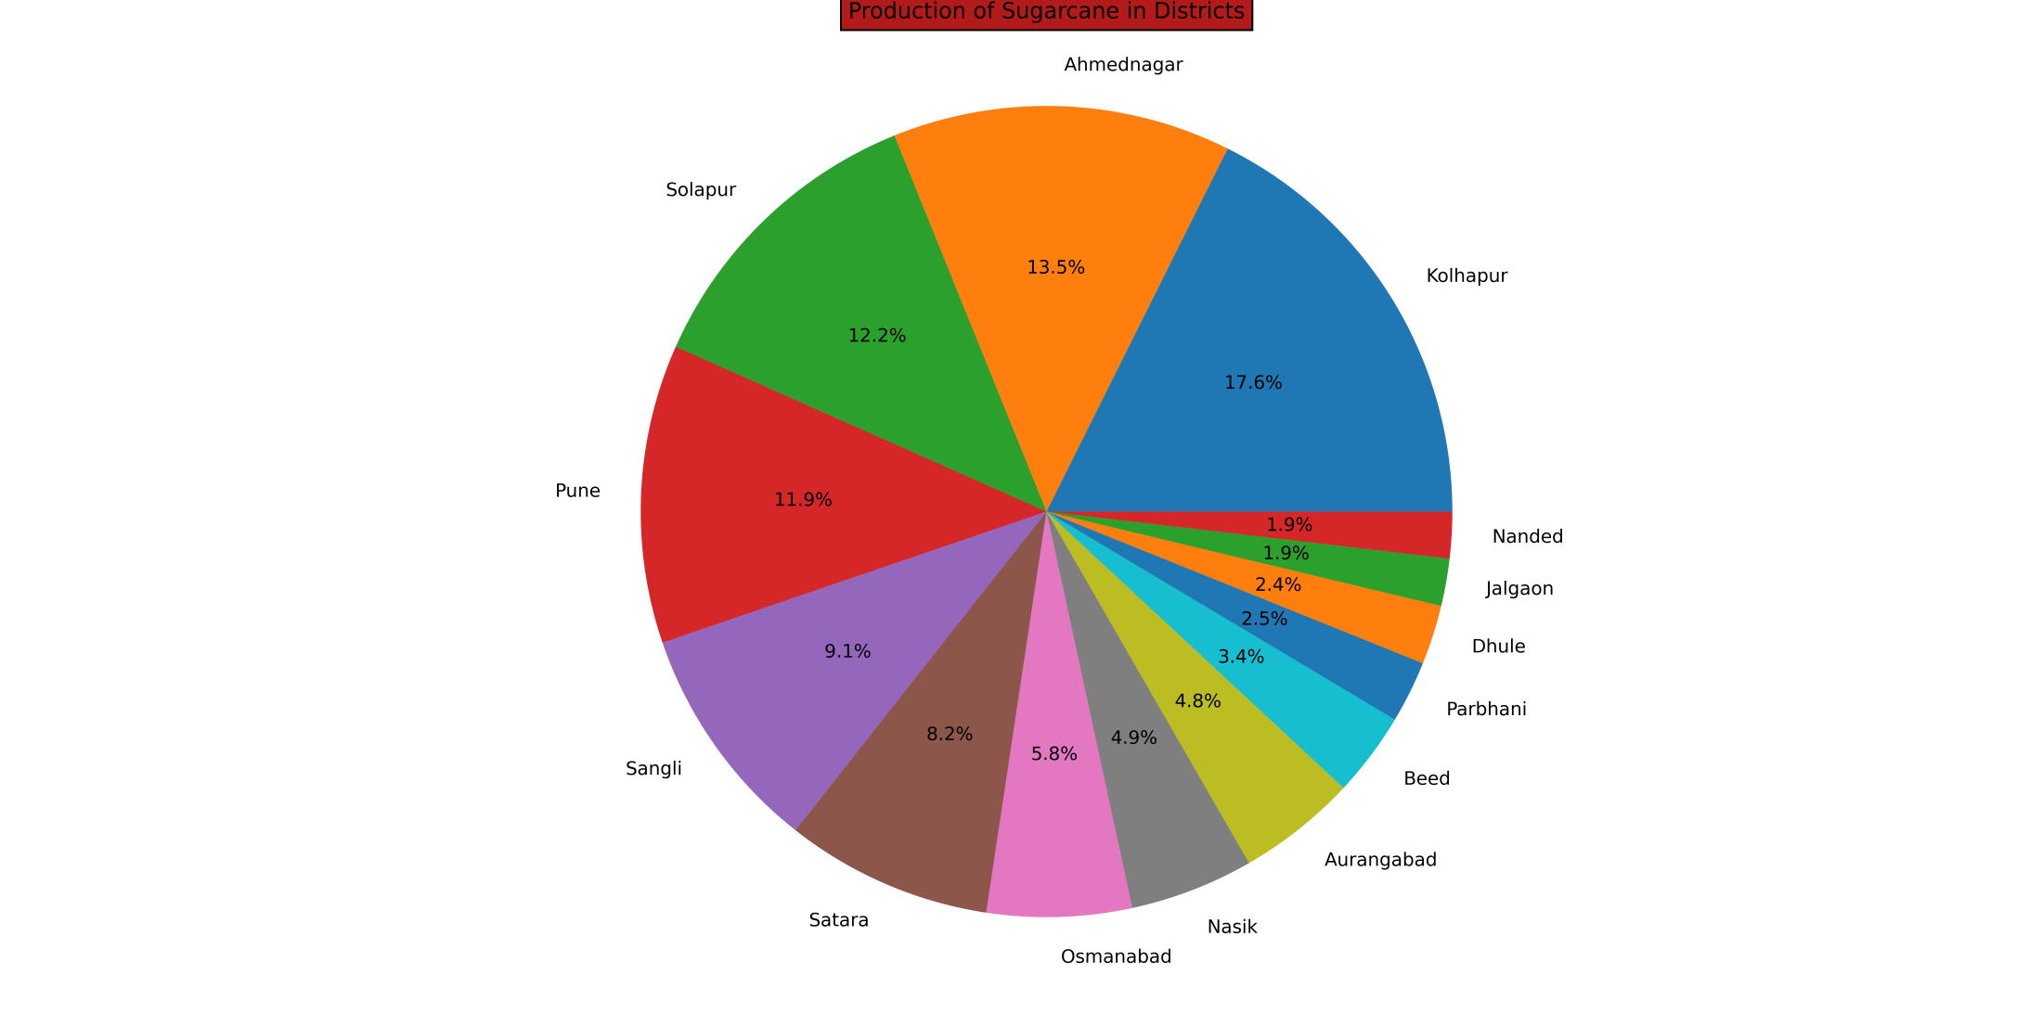

Slide 43
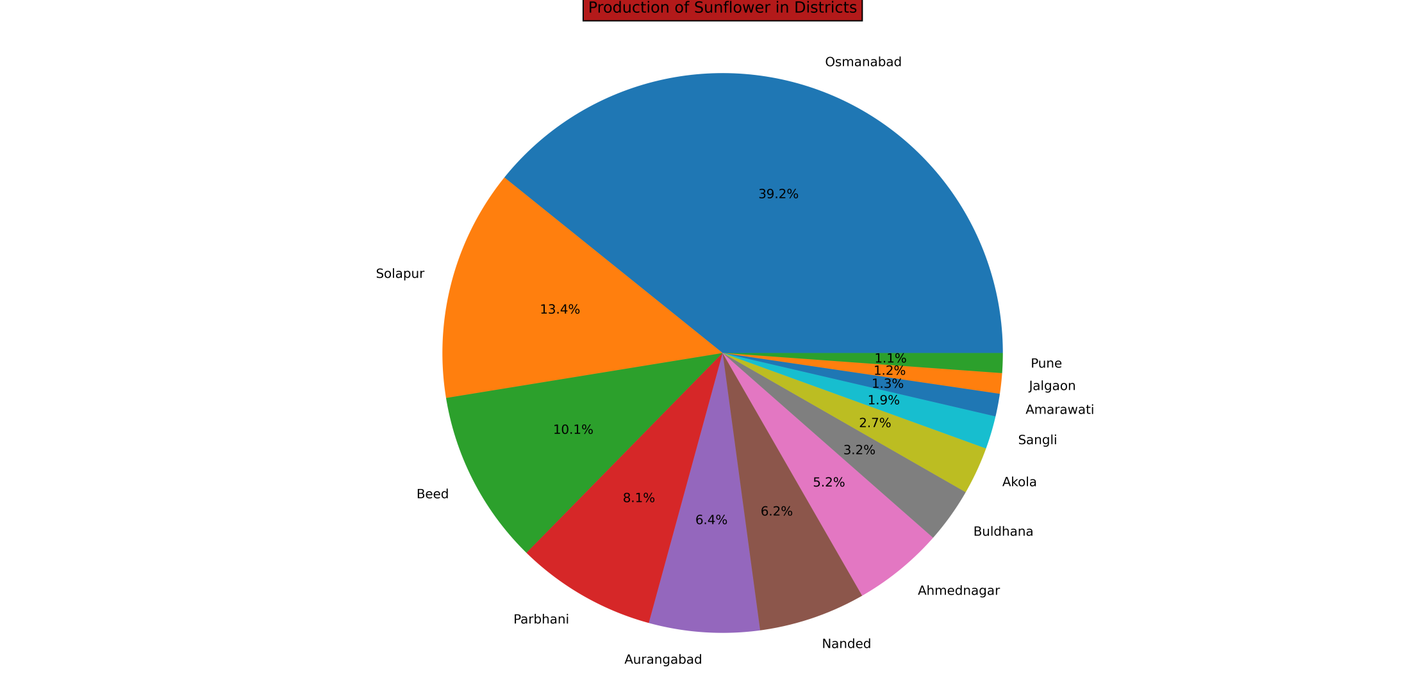

Slide 44
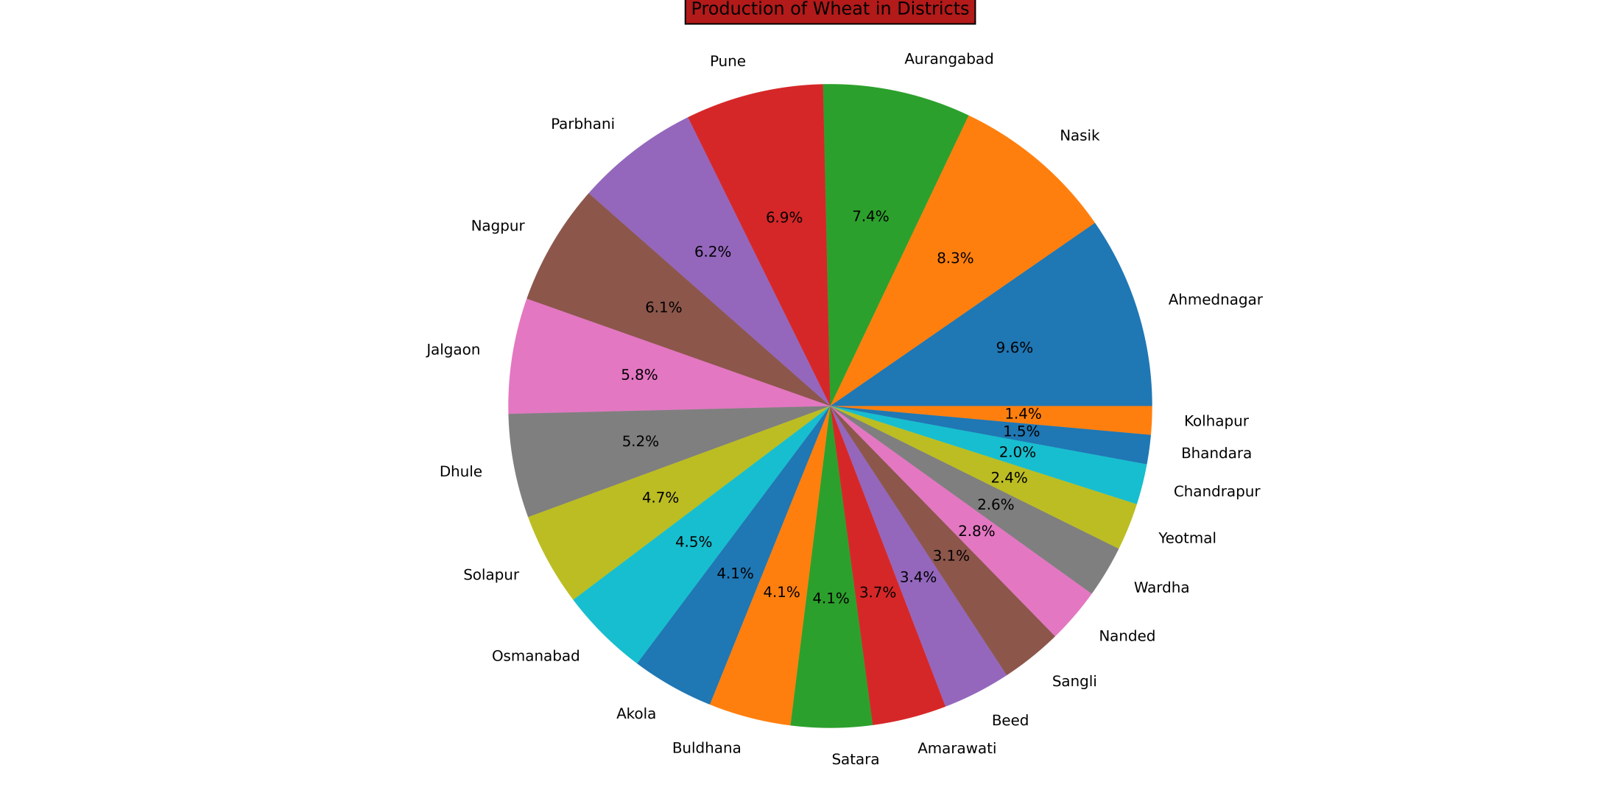

Slide 45
By using time series plots

Slide 46
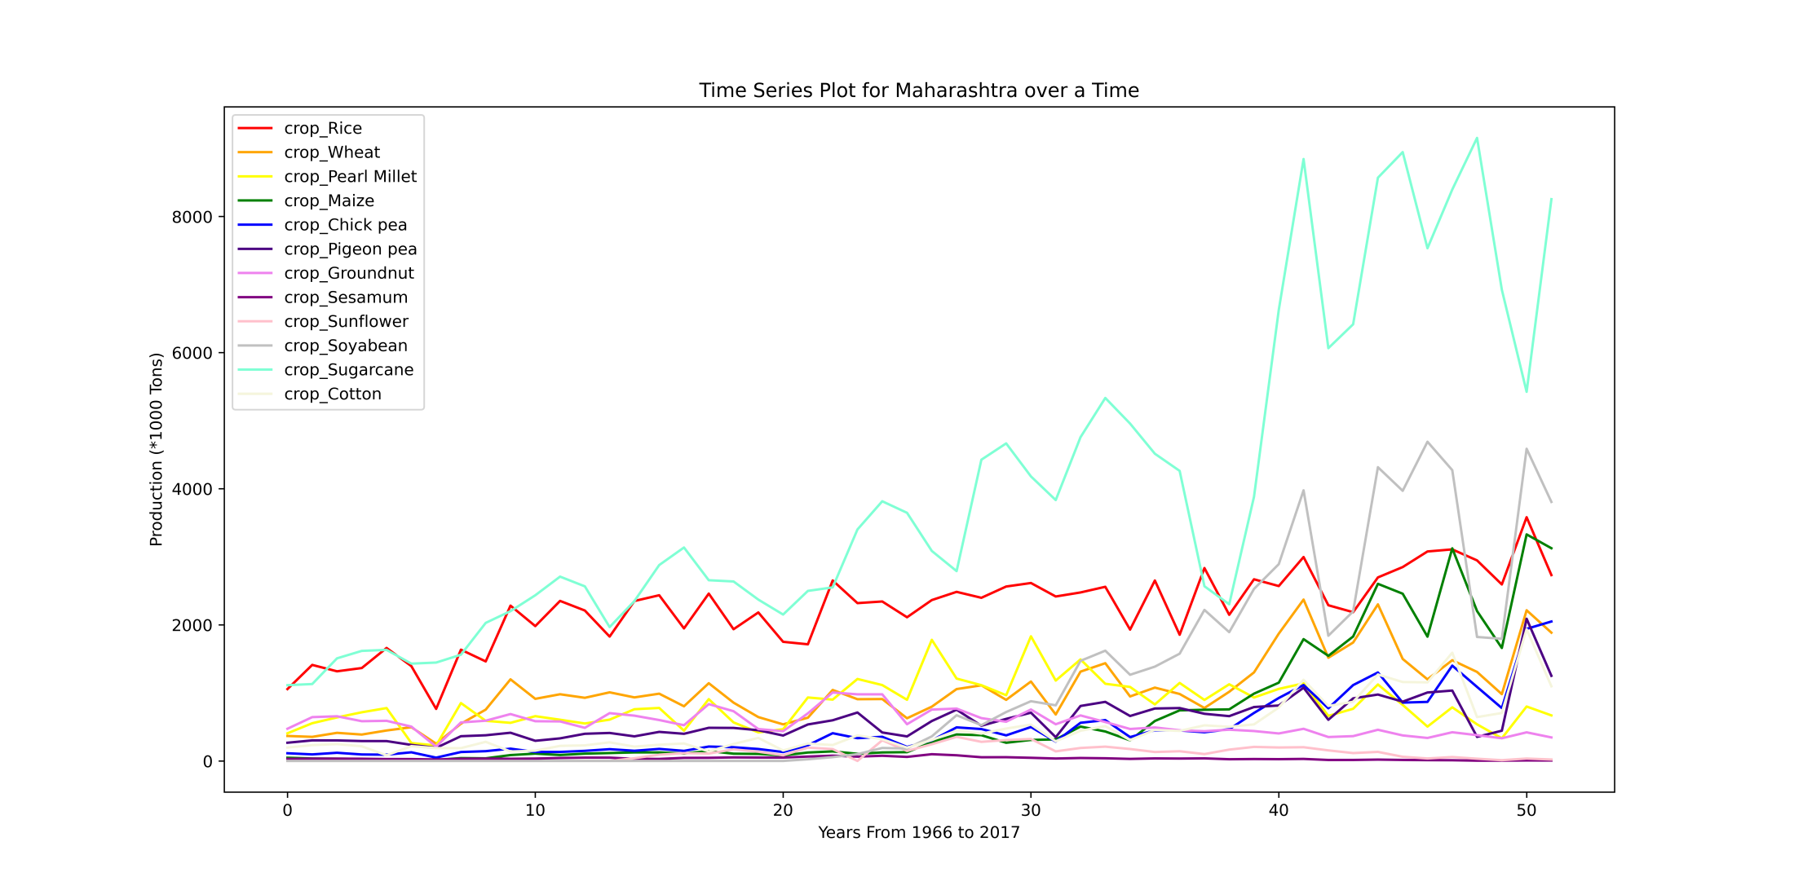

Slide 47
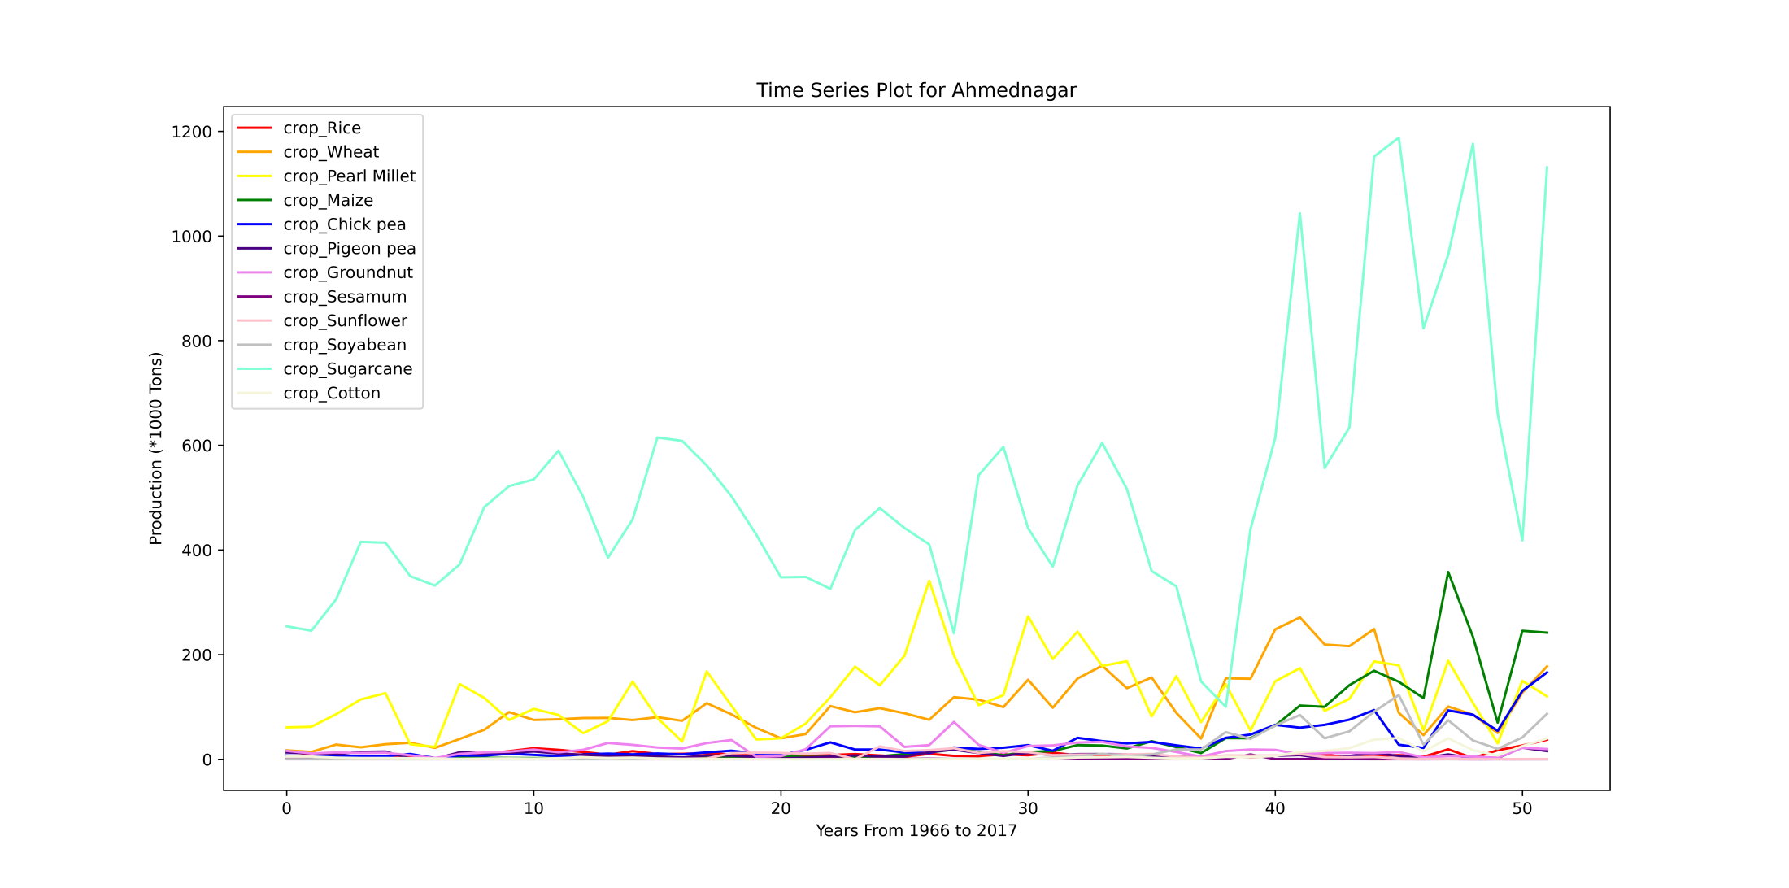

Slide 48
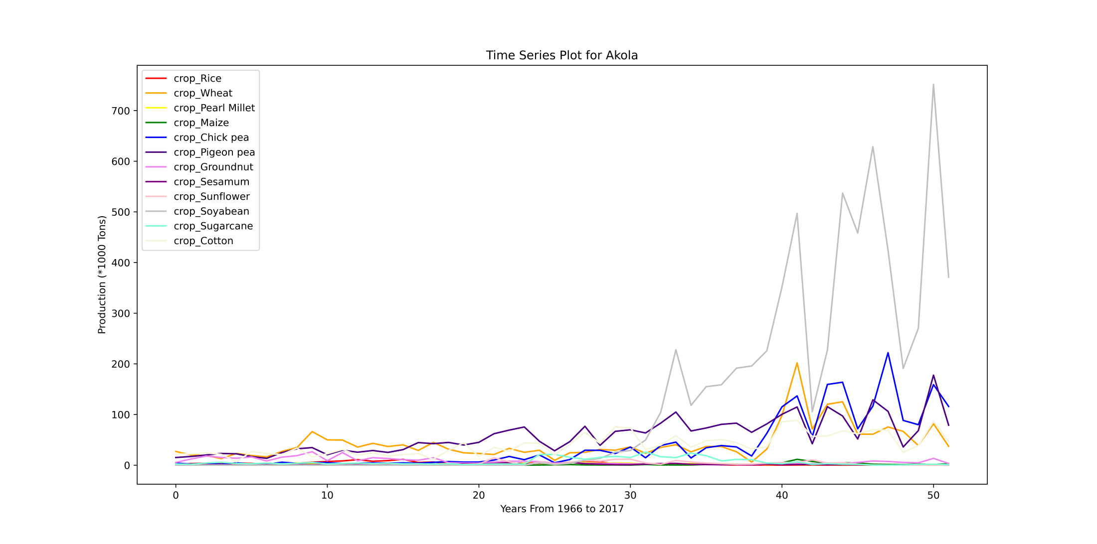

Slide 49
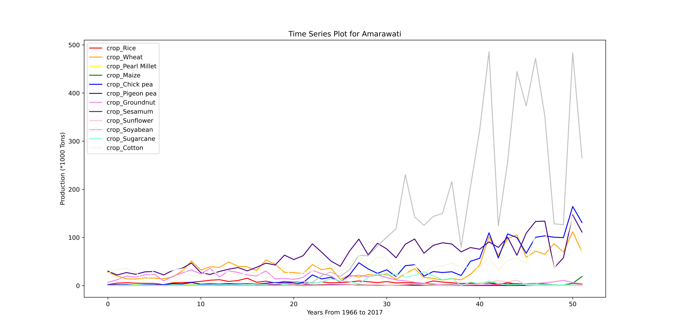

Slide 50
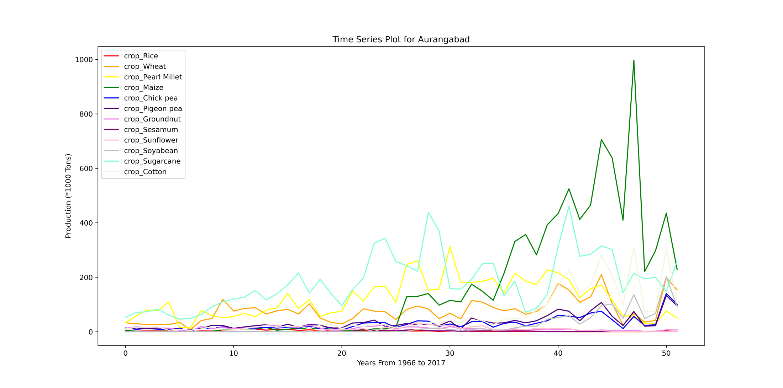

Slide 51
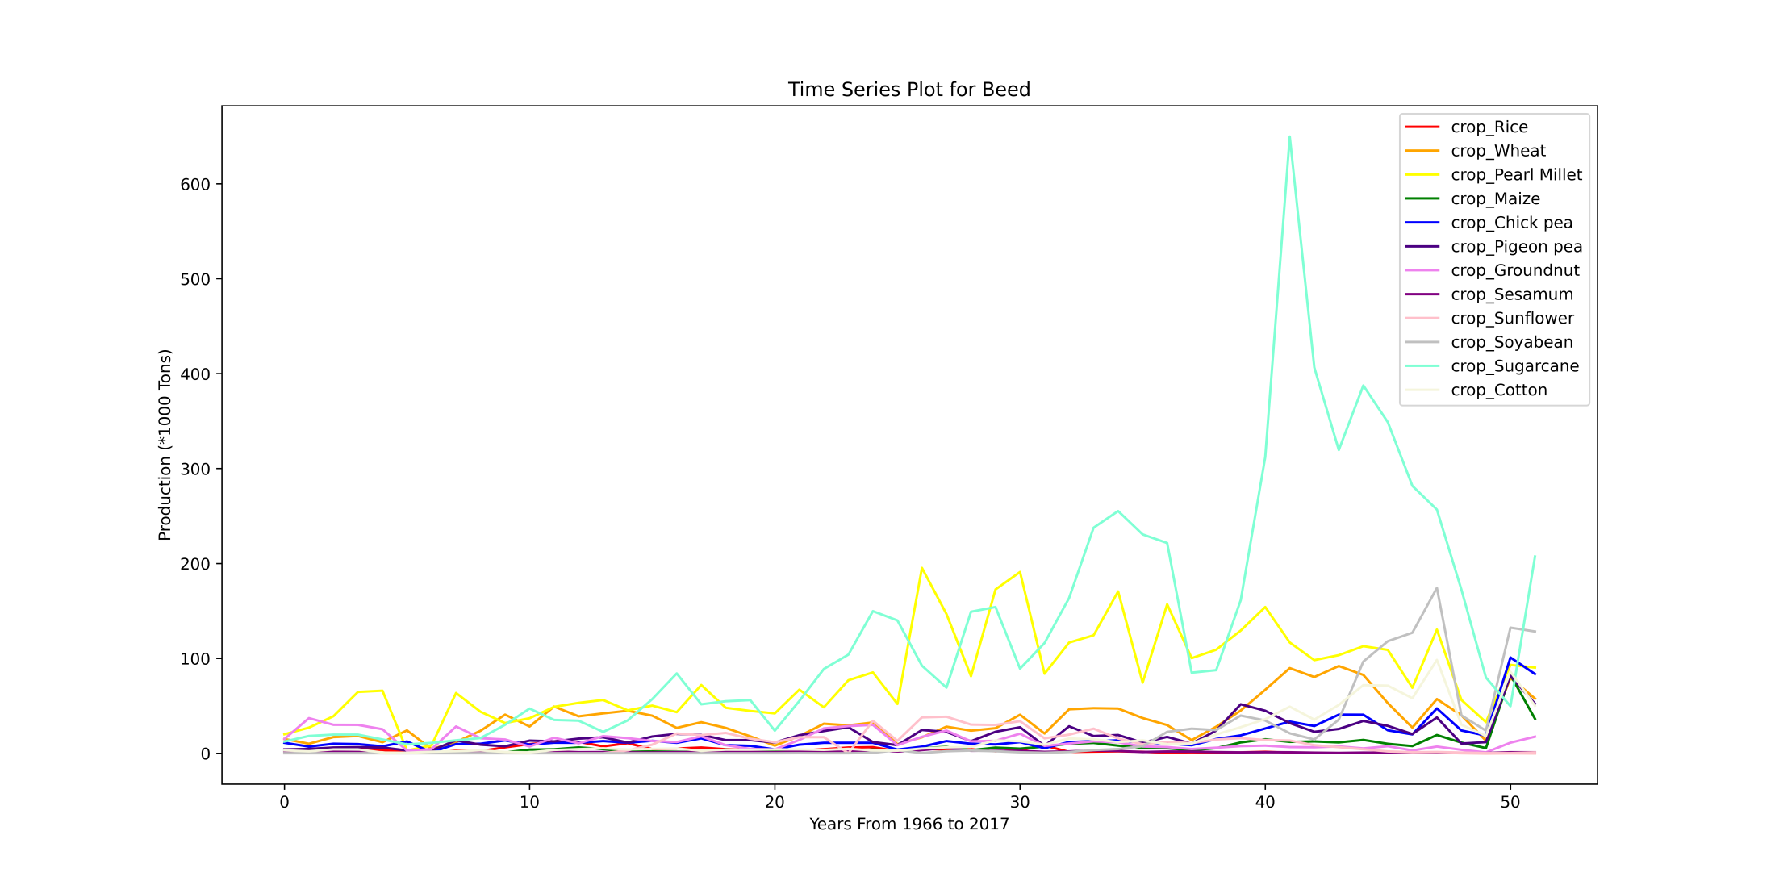

Slide 52
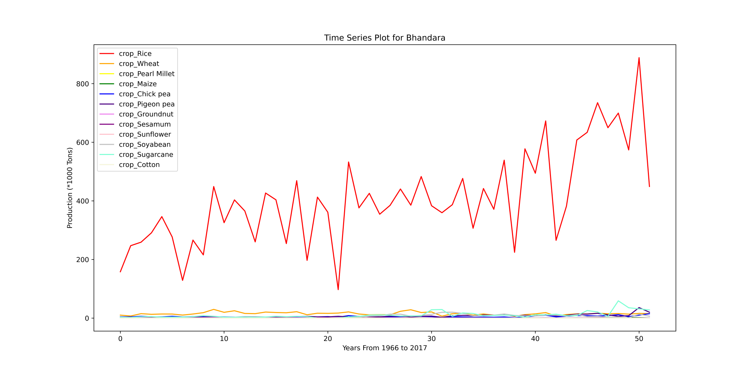

Slide 53
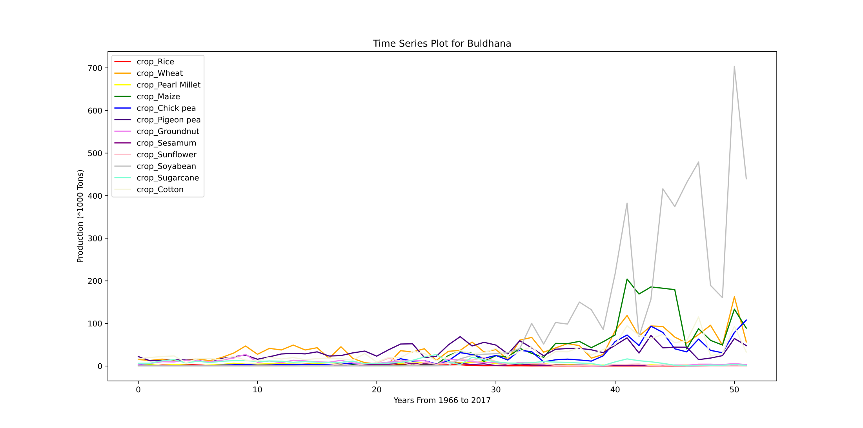

Slide 54
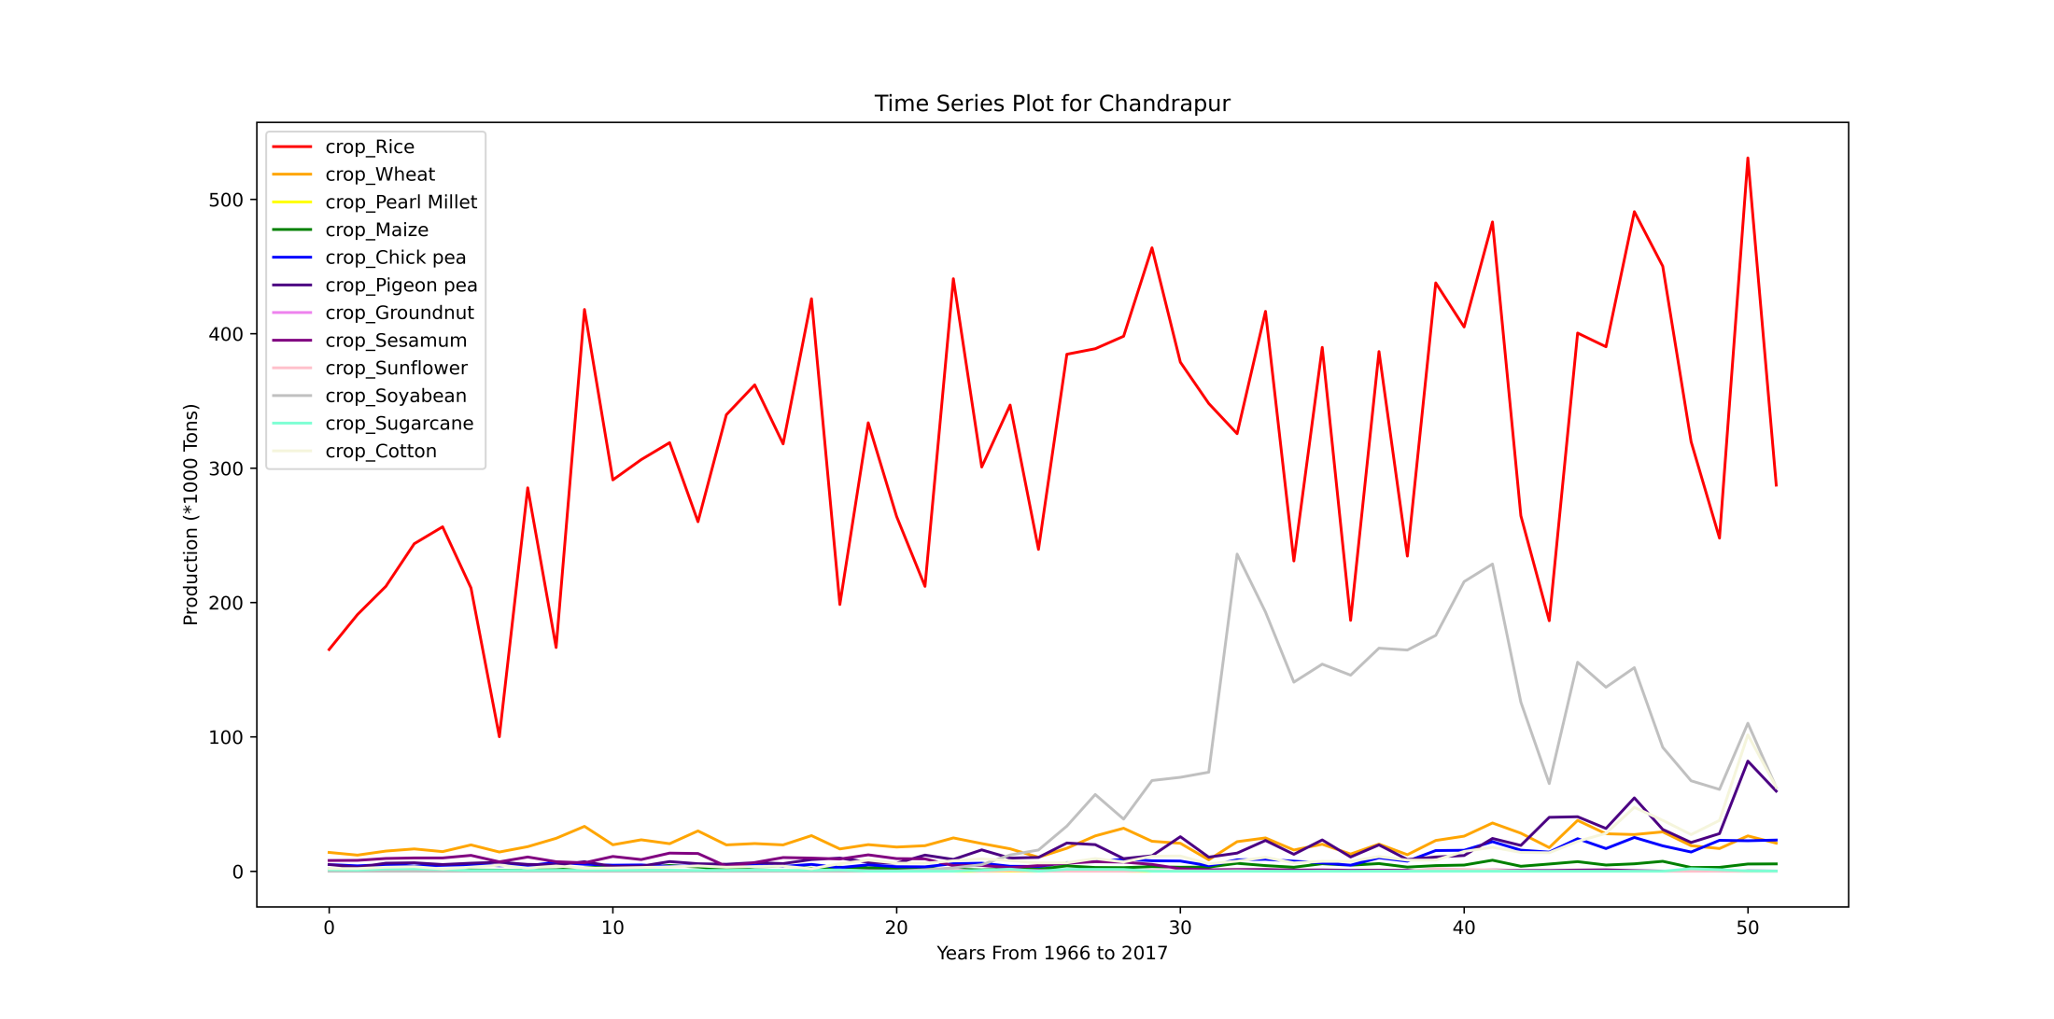

Slide 55
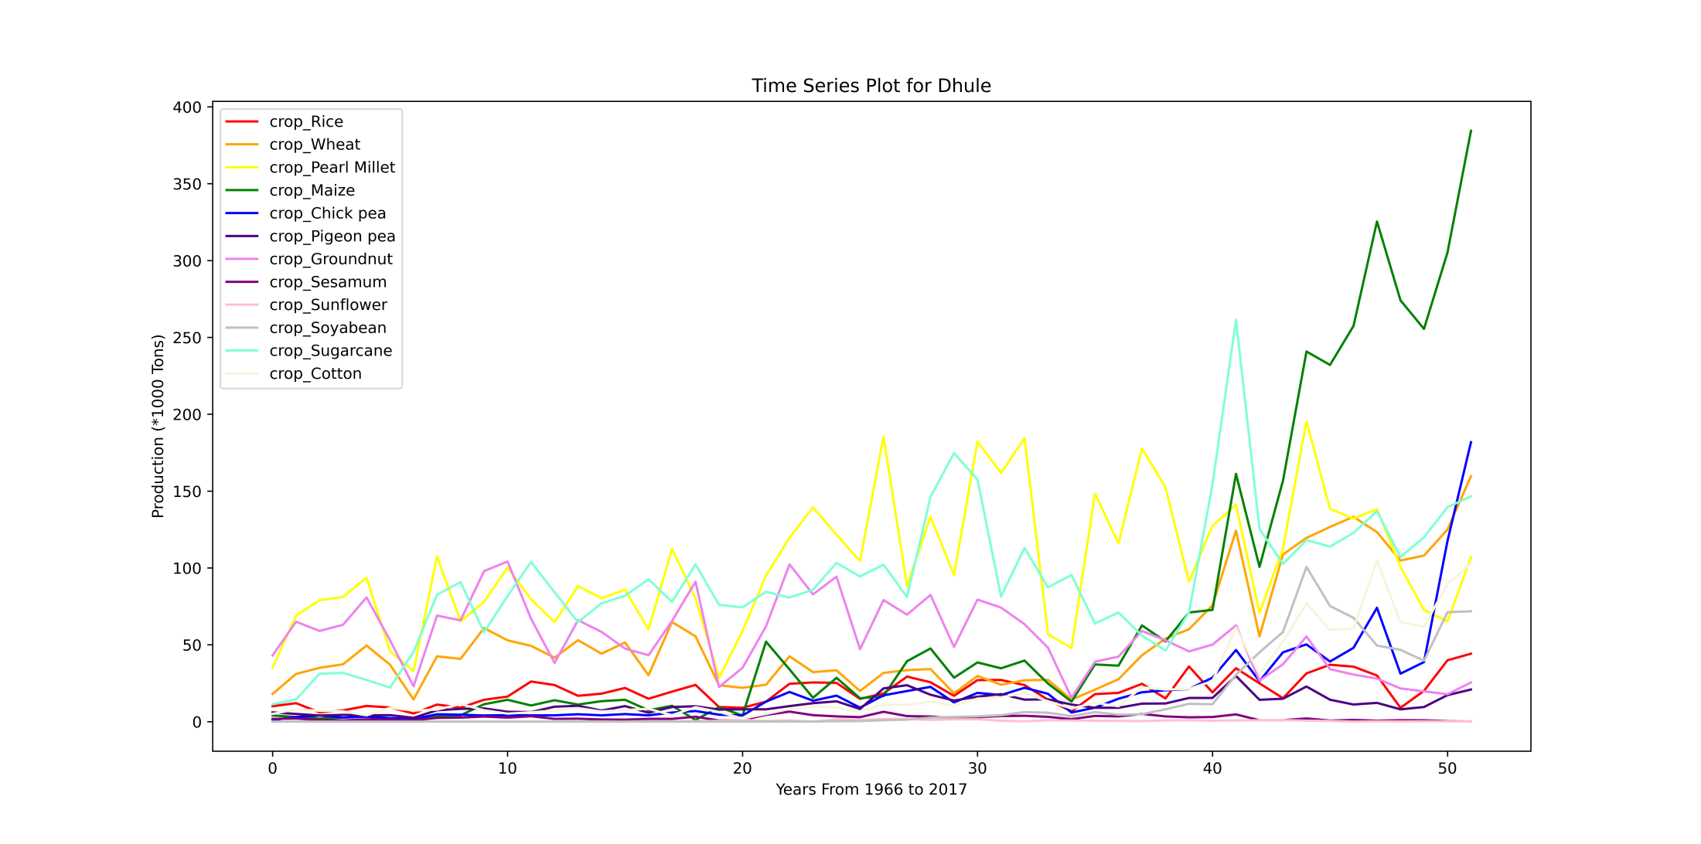

Slide 56
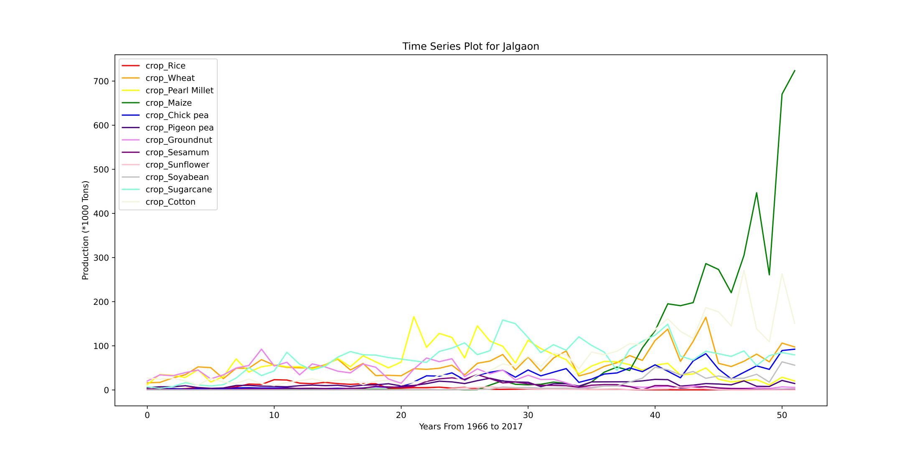

Slide 57
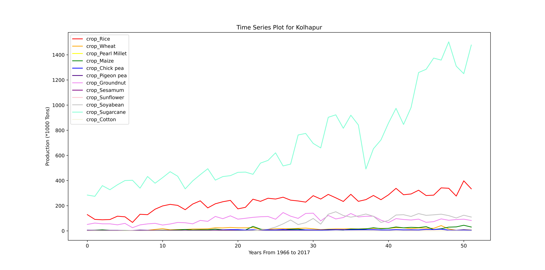

Slide 58
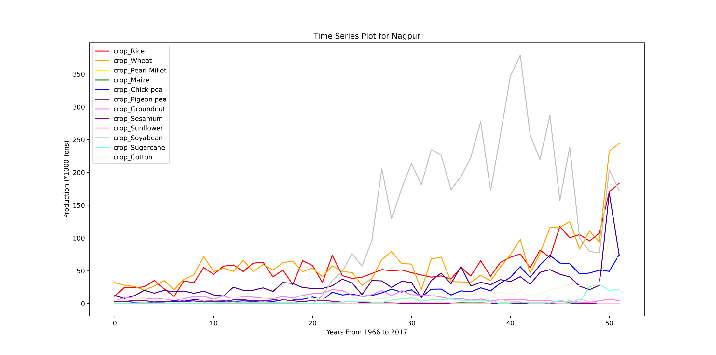

Slide 59


Slide 60


Slide 61


Slide 62


Slide 63


Slide 64


Slide 65


Slide 66


Slide 67


Slide 68


Slide 69


Slide 70


Slide 71


Slide 72
Data interpretation

Slide 73
Conclusion

